Slide 1
INSERT CLIENT NAME HERE
Your Name
Digital Media Strategist
123.456.7890
masslivesales@masslive.com

Slide 2
Current Situation for Colleges
Undergraduate Enrollment
College enrollment numbers are plateauing
90% of schools are trying to enroll 50% of available students
Average yield rate of accepted students who enroll continues to decline
High cost of enrollment per student
$331 average cost to enroll 1 student into state college
$2120 average cost to enroll 1 student into a private college *
Average student pays only 48% of full tuition
Net tuition revenue is declining
* 2014 Report - National Association for College Admission (NACAC)
Notes:
THE OPPORTUNITY
We have taken a look at your market and recognize these opportunities.
Talking Points:
x

Slide 3
Challenges of connecting with students
Current Outreach Strategies
Email
65% of teens and 76% of parents name email as their preferred method of communication
Metrics: open rate, click rate
direct mail
70% of Americans say direct mail is more personal than the internet
A majority of the population under 40 does not open direct mail
Metrics: ?
Phone
64% of Americans own a smart phone
Prefer short update text on upcoming deadlines over voice calls
Metrics: ?
Notes:
THE OPPORTUNITY
We have taken a look at your market and recognize these opportunities.
Talking Points:
x

Slide 4
Influencers of Student Decisions
Now and then – How to connect in the future?

Slide 5
A clear, efficient path forward
BUILDING THE NEXT CLASS OF FRESHMAN
LAUNCH
COLLABORATION
OPTIMIZE
Student CRM Analysis
Understand behaviors, interests of your accepted students and their parents
GROW
Outreach Strategy
Strategy to reach each student and their parents with the right message through the right channel
Deliver
The right message through the preferred channel with the right frequency
Notes:
OUR PROCESS
This infographic shows how we put our client’s plans into action.
Talking Points:
We build partners for life by proving the effectiveness of our campaigns time and time again.
We want to efficiently build and deliver a marketing strategy with complete transparency in collaboration with you.
(if applicable) We have already gone through a preliminary discovery with you to understand your objectives:
Objective 1
Objective 2
Objective 3
Based on these objectives, we met with our leading digital strategist to build a custom solution for you.
We will swiftly implement your plan and...
Launch your creative (which you indicated you’d like us to do / which you indicated you will provide)
We will track, measure and optimize your campaign
We will look for opportunities to maximize your results and grow your business
Optional:
In the U.S., 61% of digital use is from mobile devices, with 43% from mobile apps.
The online desktop audience represents 39% of the market and is shifting to mobile.

Slide 6
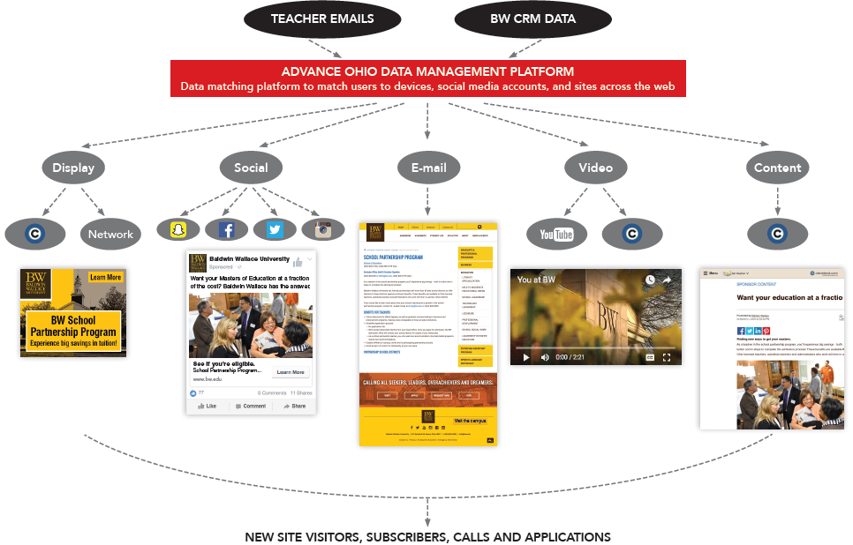
Our approach
Personalized
Targeted
Trackable
MASSLIVE MEDIA DATA MANAGEMENT PLATFORM
Data matching platform to match users to devices, social media accounts and sites across the web

Slide 7
Path to Enrollment
Example: Critical Touchpoints of Engineering Student
AWARENESS
APLICATION
ENROLLMENT
DEPOSIT
Need to add touchpoint examples – maybe some graphics instead
Digital Display with call-to-action
Email supported by Digital Display
Social Media
Notes:
OUR APPROACH
This graphic chart demonstrates our approach to build you a campaign that works.
Notes:
Use this slide to demonstrate our approach to the challenge.
A supplement for this slide can also be created with an investment calendar built in Excel.
Product-specific slides can also be included to support tactics for the overall campaign.
Talking Points:
Layers of interaction produce layers of results.
This is your customer marketing strategy and how we will position each tactic.
Walk through each tactic, pointing out how it will be positioned to the client’s audience at each stage.
Please note that this model moves from left to right (high funnel to low funnel)
In order to build your business, we put the most resources on your largest audience – the AWARENESS phase.
This is your largest pool of potential advertisers. All other phases are segments of this audience over time.

Slide 8
Tracking Enrollment Intend
We agree on the same Key Performance Indicators to Prove Success:
Traffic increase
Click through rate
Page views
Email opens
Email forwards
Email link & attachment views
To gather data, we’ll use the following:
UTM Codes
Pixels
Google Analytics
Notes:
Before we tell you that cleveland.com needs to do x, we want you to focus on using Paywalls limit traffic and contradict programmatic approach
Contradict idea of monetizing data, as they limit traffic

Slide 9
Higher education clients
Advance strives to deliver student-centered marketing solutions that deliver ROI for our education clients – from large universities to local community colleges.

