Slide 1
Better reader experience, better advertiser results.
Brand exposure opportunities on the new MassLive.com homepage.
May 2018

Slide 2
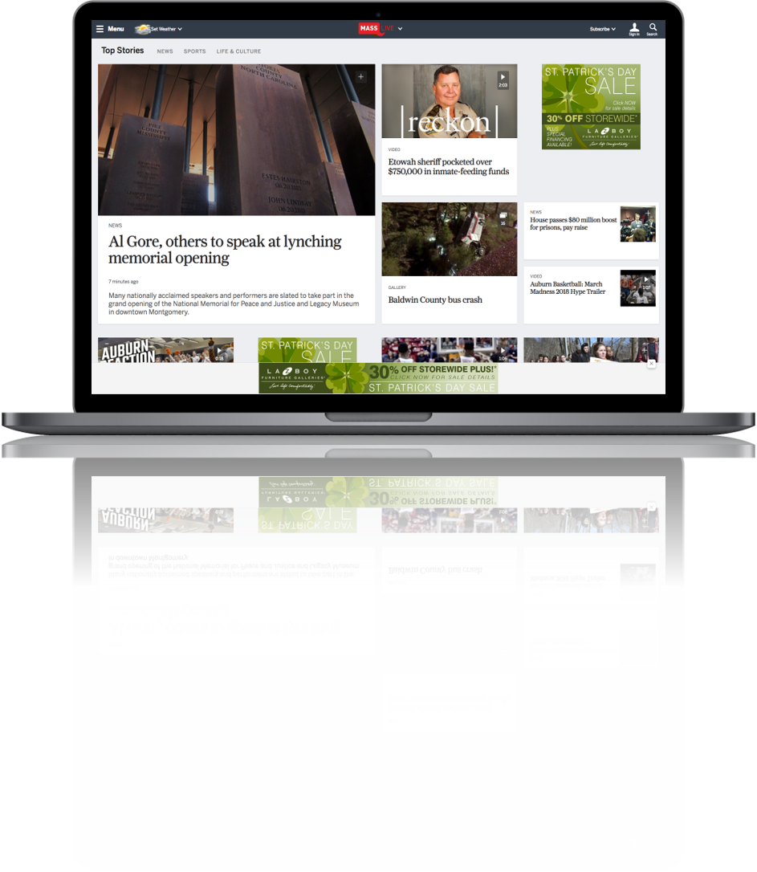
The new MassLive.com homepage
New, modern layout is responsive and adaptive to any device.
The homepage now has dedicated sections
News is organized to make sure readers don’t miss the most up-to-date and important stories
Notes:
Talking points:
MassLive.com strives to improve user experience while also improving ad engagement in a mobile-first world, starting with the MassLive.com homepage.
The new design increases engagement, which in turn, increases the amount of time spent with both content and advertising.
The new, responsive design also accommodates more ads
We have had to update our advertising options to seamlessly integrate into this improved user experience.
The ultimate outcome will be a better ROI for our advertisers.

Slide 3
There has never been a better time to advertise on MassLive.com
The new homepage is designed to deliver a clean, fluid reading experience on desktop and mobile.
Ads are more integrated with content, increasing engagement and conversion.
The new adhesion unit follows the reader without being intrusive.
Advertisers can now dominate homepage advertising positions on all devices without a separate buy.
Buy directly through a MassLive.com representative to take advantage of these new advertising opportunities.

Slide 4
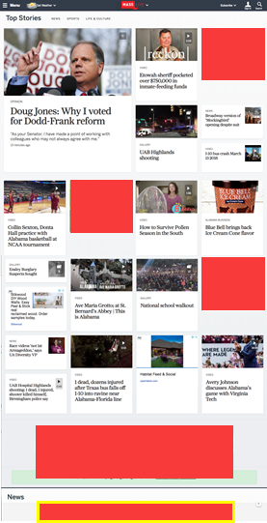
Roadblock/Takeover
AD 1
NEW
AD 2
SOLD DIRECT ONLY
Make a big splash on the MassLive.com Homepage on both Desktop and Mobile
Two options:
Roadblock – Top four ads on desktop and mobile
Takeover – Top four ads plus adhesion unit on desktop and mobile
AD 3
AD 4
ADHESION AD

Slide 5
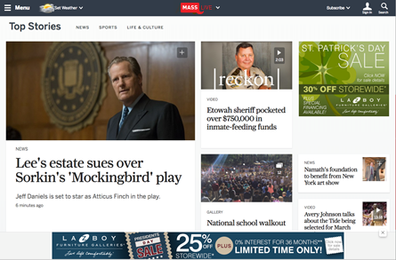
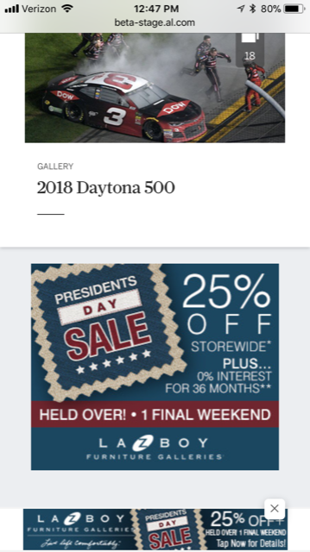
Adhesion Unit
NEW
SOLD DIRECT ONLY
Adhesion ad units stay on the page as the user scrolls down on their smartphone or desktop computer.
970 x 90 desktop adhesion ad unit
320 x 50 mobile adhesion ad unit

Slide 6
Early reader response.
“This is so much better than your current format. Too much scrolling and going by old news stories to get to new ones. Like this much better.”
“Excellent presentation, and news selection is great.”
“Love the new site’s layout, especially the quick view on each article. The speed of the site seems improved. Overall it feels a lot cleaner.”
“I love the new page ... made me want to read stories that I would not have even noticed on the current site. Very contemporary!”

