Slide 1
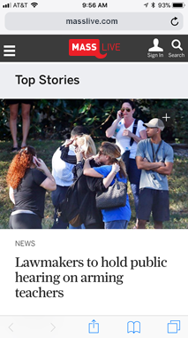
Improving the reader experience.
What’s behind the MassLive.com homepage redesign and how it impacts you.
May 2018

Slide 2
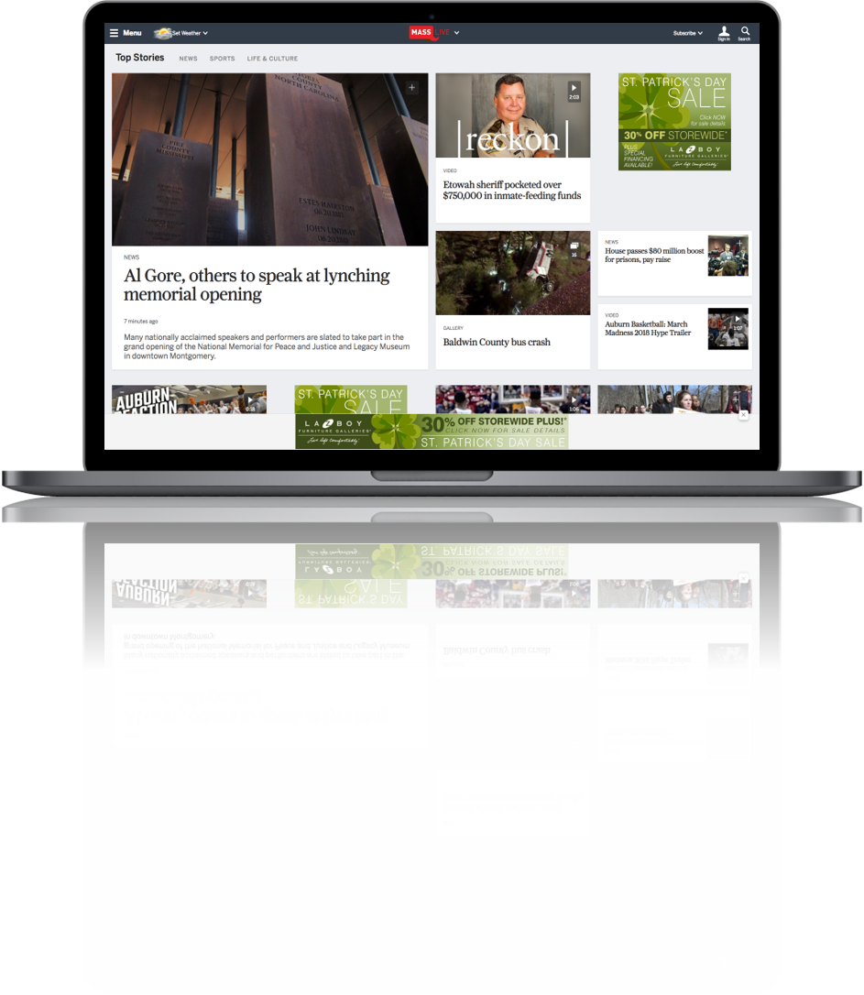
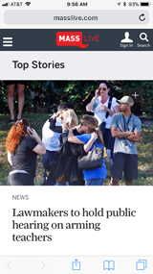
The new MassLive.com homepage
Goals:
Increases engagement
Increases advertisers’ share-of-voice on mobile
Improves ad quality
Improves user experience
Increases advertiser ROI
Notes:
Talking points:
AL.com strives to improve user experience while also improving ad engagement in a mobile-first world, starting with the AL.com homepage.
The new design increases engagement, which in turn, increases the amount of time spent with both content and advertising.
The new, responsive design also accommodates more ads
We have had to update our advertising options to seamlessly integrate into this improved user experience.
The ultimate outcome will be a better ROI for our advertisers.

Slide 3
Early reader response.
“This is so much better than your current format. Too much scrolling and going by old news stories to get to new ones. Like this much better.”
“Excellent presentation, and news selection is great.”
“Love the new site’s layout, especially the quick view on each article. The speed of the site seems improved. Overall it feels a lot cleaner.”
“I love the new page ... made me want to read stories that I would not have even noticed on the current site. Very contemporary!”
We have been testing the new site design with select users for several weeks and here is some of the feedback.

Slide 4
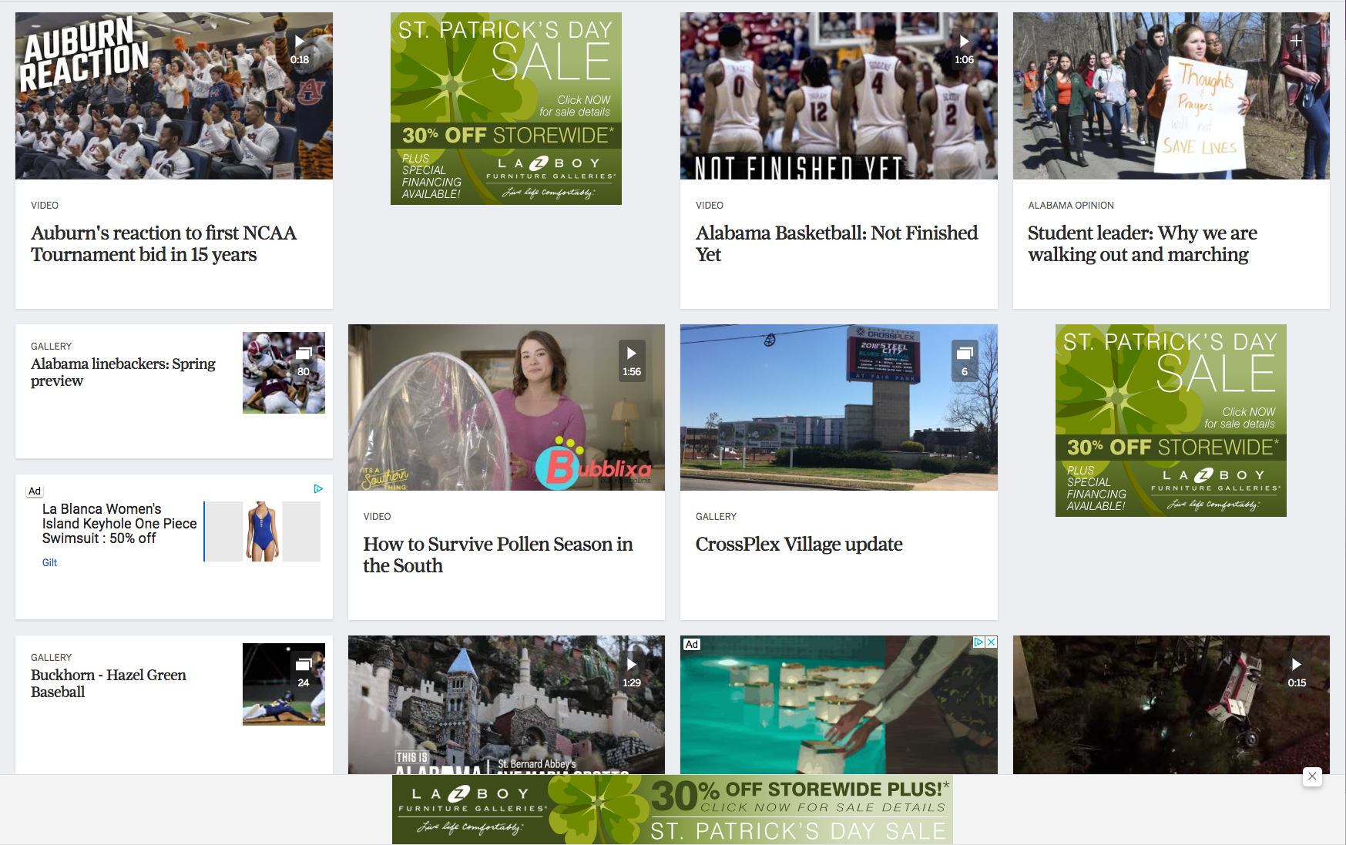
Advertiser advantages.
Ads are integrated with content, increasing engagement and conversion.
Better Ad Positions Ads are positioned to be consumed as content instead of falling into “blind spots” for better viewability.
Better Takeovers You can now own every ad position on desktop and mobile because of the new fully responsive grid layout.
Better Native Advertising Two sponsored content sizes integrate with site articles and videos.

Slide 5
Optimizing for ad performance
On the right: a reader engagement heat map, overlaid on the old site design.
The new design increases ad load where it counts.

Slide 6
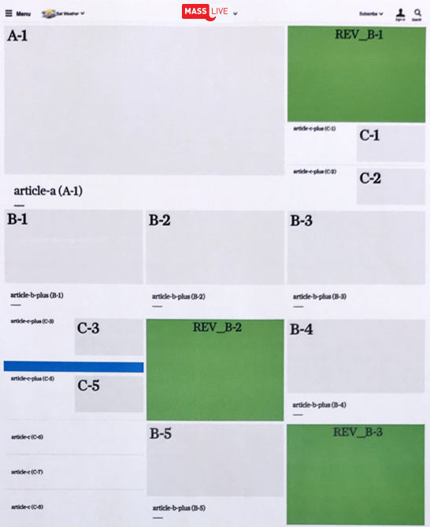
How the new homepage is organized.
The A unit is the focal point on the page; it is designed to live at the point on the page that draws maximum attention from the reader and can serve a traditional text story, a gallery, or a video.
The new home page is organized around a repeating grid that delivers content and advertising in a flexible yet structured manner.
The B units can serve text, video, or native ads, and support modal windows.
The C units can link to content, serve video, or serve native advertising.
Banners and rectangles ads are served within the grid structure to combat banner blindness.

Slide 7
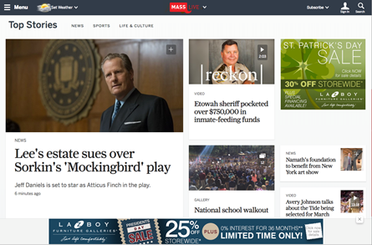
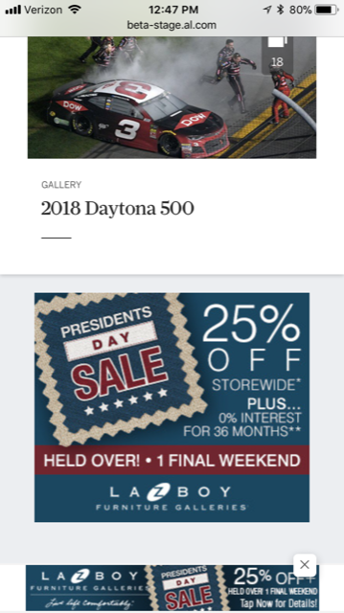

Slide 8
In/Out.
Desktop/Mobile Adhesion
Desktop/Mobile Roadblocks
Improved Homepage Takeovers
Enhanced Native Content and Native Ad Opportunities
Modal/Preview Windows
Wallpaper
Expanding Units (on the homepage)
IAB Rising Star Units

Slide 9
Adhesion Unit
NEW
SOLD DIRECT ONLY
This 970 x 90 ad stays on the page as the user scrolls down the page.

Slide 10
Mobile Adhesion Unit
NEW
SOLD DIRECT ONLY
This 320 x 50 ad stays on the page as the user scrolls down on their smartphone.

Slide 11
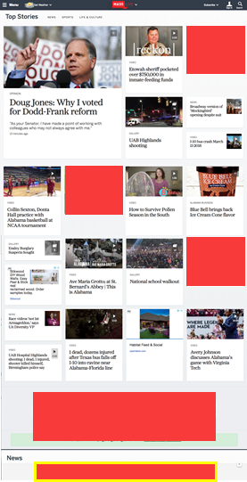
Roadblock/Takeover
AD 1
NEW
AD 2
SOLD DIRECT ONLY
AD 3
Two options:
Roadblock – Top four ads on desktop and mobile
Takeover – Top four ads plus adhesion unit on desktop and mobile
* Priced only for the main MassLive.com home page. Other home pages require custom pricing.
AD 4
ADHESION AD

Slide 12
MassLive.com homepage high-impact rates.
NEW
High Impact Program Details | Full Audience | Statewide | Springfield DMA
Adhesion Units: 970x90 (Desktop), 320x50 (Mobile) | $3,000 | $2,500 | $2,000
Takeover: Rectangle 1, 2, 3 + Static Billboard 970x250 + 970x90 Adhesion Unit (desktop) AND Rectangle 1, 2,3,4 + 320x50 Adhesion Unit (mobile) | $6,500 | $5,000 | $4,000

Slide 13
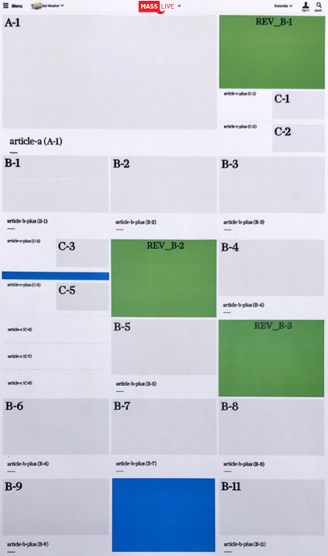
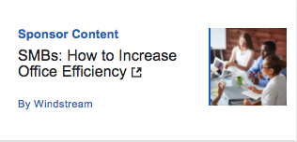
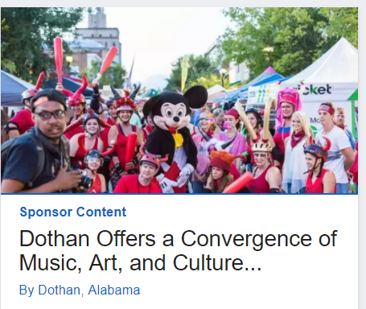
Native ad positions
Up to two native ads will display on the homepage in any of the B or C positions within the new content grid
Native content can include an article or video

Slide 14
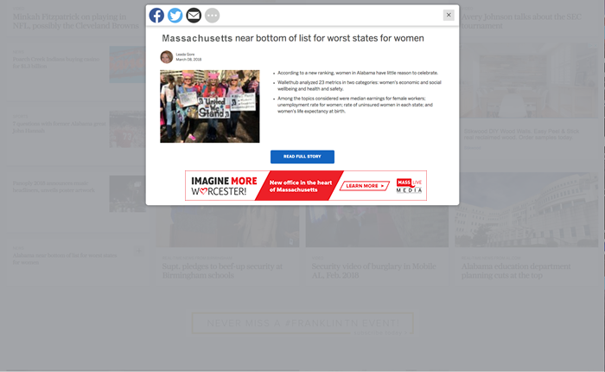
Article Preview Box
NEW
Some content has a preview option.
Look for plus signs and gallery icons.

Slide 15
What do we stop selling?
What do we start doing?
Sell homepage roadblocks and adhesion units
Use the High Impact Calendar to reserve these campaigns
Separate RRM campaigns from home page placement campaigns
Incorporate “Native” Inspired ads into home page placement
Wallpaper
IAB Rising Stars
Expanding ads (homepage)

Slide 16
Key takeaways.
There has never been a better time to advertise on MassLive.com.
The new homepage is designed to deliver a clean, fluid reading experience on desktop and mobile.
Ads are more integrated with content, increasing engagement and conversion.
The new adhesion unit follows the reader without being intrusive.
Advertisers can now dominate homepage advertising positions on all devices without a separate buy.
Buy directly through an MassLive.com representative to take advantage of these new advertising opportunities.

