Slide 1


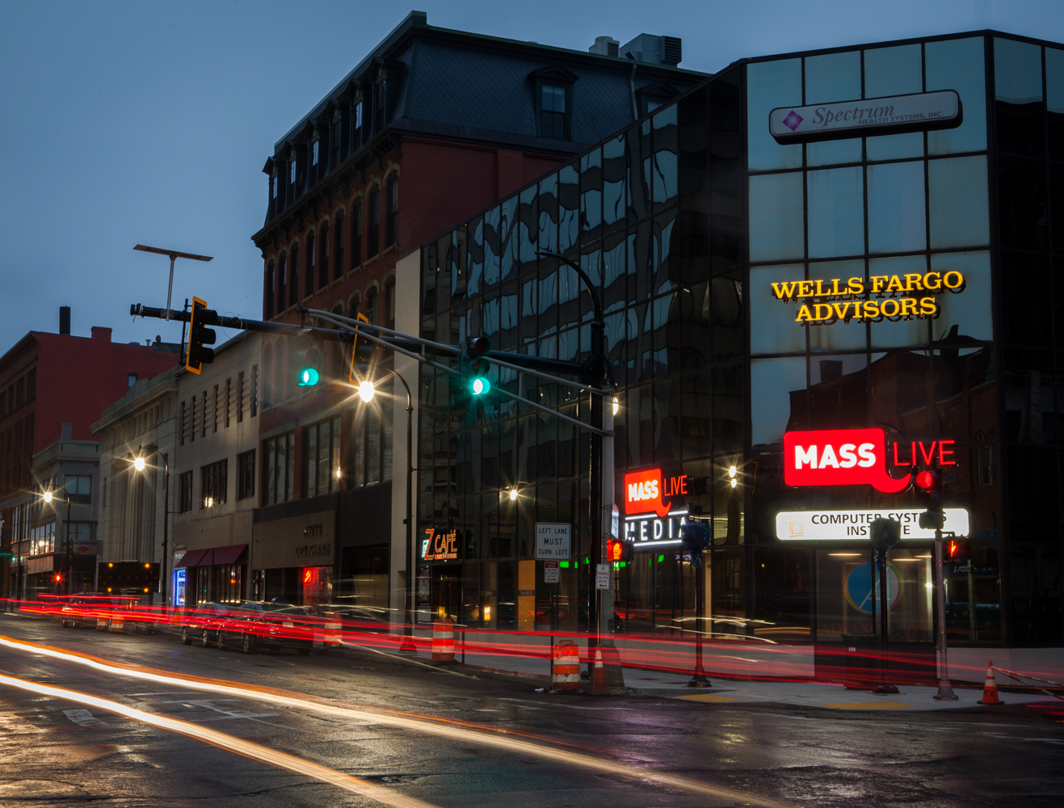

DIGITAL MARKETING & HOME IMPROVEMENT
Notes:
Will update with new pic of Worcester office

Slide 2


NAVIGATE THE DIGITAL MARKETING LANDSCAPE IN THE HOME IMPROVEMENT SPACE WITH MASSLIVE MEDIA
The Importance of Your Website
Connect with New & Existing Customers
Showcase Your Team, Products, & Services

Slide 3
Navigate Digital Marketing Landscape in the Home Improvement Space
The Importance of Your Website
Connect with New & Existing Customers
Showcase Your Team, Products, & Services
  Video Production & Marketing
with MassLive Media
Industry Experience
Seasonal Flexibility
Consistent Campaign Optimization
Campaign Performance Reporting

Slide 4
THE IMPORTANCE OF YOUR WEBSITE
Building & Optimizing Websites
Creating a Positive User Experience
Landing Pages & Best Practices

Slide 5
The Importance of Your Website
75% of buyers admit to making judgements on a company’s credibility based on the company’s website design.
What they say is true, you only get one shot at a first impression – and the impression you make online has never been more important.
  Consider your website your online store, even it isn’t not an e-commerce site. You want to make a good impression and provide a good experience the same way you would if the customer was to walk in through your doors.
  You want your website to not only let new and existing customers know who you are and what products and service you provide, but what sets you apart from your competitors and the big box stores
  Amid the Covid-19 pandemic, online research and shopping has never been more prominent – make sure your website gives customers away to safely connect with you regarding their needs and how you can help – such as sales assistance, online or phone orders, curbside pickup services, etc.
Source: SWEOR “27 Eye-Opening Website Statistics: Is Your Website Costing You Clients?”. April, 2019 themes.responsively.com

Slide 6

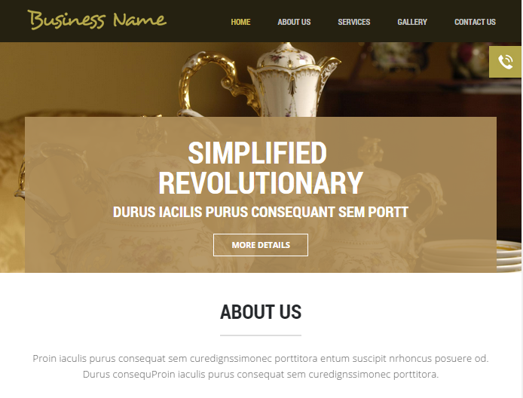

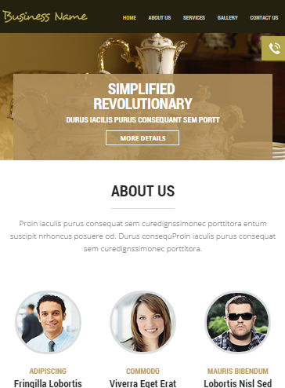


Landing Pages & Best Practices
  Dedicated landing pages for each product and service category
  SEO friendly content
  Custom, mobile-friendly site
  Unlimited content
  Real-time analytic reporting
  Google Maps Integration
  Email account setup
  Customer and SEO friendly page speed
  Form fills & Click to Call

Slide 7
CONNECT WITH NEW &
EXISTING CUSTOMERS
Building Brand Awareness
Search Engine Marketing (SEM)
Social Media Advertising

Slide 8
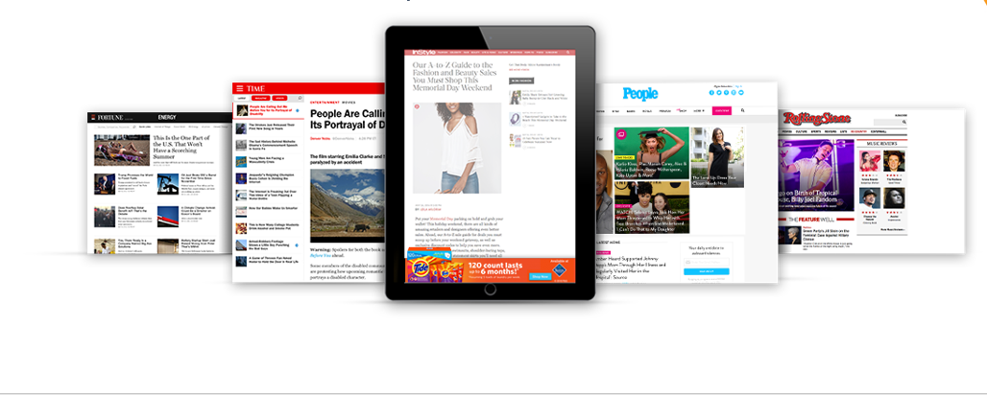
Building Brand Awareness
Over 95% of online time is spent on content sites.
  Use local, trusted content sites like MassLive.com or Network Display ads to build brand awareness and trust
  Align with the content your customers are investing their time in
  In most cases, display advertising can be submitted for co-op reimbursement
  Strategically target your ideal customers in your preferred geographical area(s)
  Incorporate tactics like Site-Remessaging, or Retargeting, to maintain top-of-mind awareness to customers who have visited your site
  Multiple store locations? No problem! Use store-specific ads to target customers in specific geographies all within the same campaign.
  Easily swap ads in and out according to season, sales, etc.
Measurable KPIs:
Impressions
Clicks & CTR
Avg. In-View Time
Total Exposure Time

Slide 9
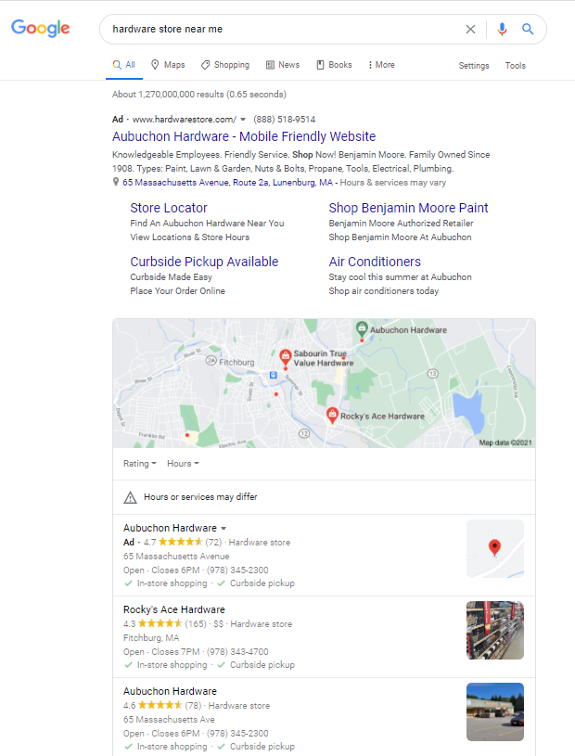
Search Engine Marketing (SEM)
Appear in the top search results when customers are actively looking for your products and services
Measurable KPIs:
Impressions
Clicks & CTR
Call Tracking & Phone Number Clicks
Goal Conversion Rate
Impression Share
  Give us some high-level information – like what you’d like to be found for and where geographically you’d like to be found – and let us provide you with strategic “Good”, “Better”, “Best” budget levels and expectation for a successful campaign
  You can even target specific, local competitors so you can be found when their names are searched for
  Our platform grants us the ability to provide consistent optimization opportunities, performance reviews and a customer-friendly dashboard

Slide 10

Social Media Advertising
Whether you’re looking for assistance in managing your social pages or looking to grow your following and increase your Likes, we’re here to help!
We can manage your social accounts for you to ensure consistent posting, increasing followers and maintaining relevant content.
We can design an advertising campaign targeting look-alike-audiences, enabling you to appeal to users that “look” like your current fans and followers but aren’t following you – yet.
Use consistent ad campaigns or simply promote specific sales or events throughout the year.
Measurable KPIs:
Impressions
Profiles Reached
Clicks & CTR
Views to 25%, 50%, 75%, & 100% (video ads only)

Slide 11
SHOWCASE YOUR TEAM,
PRODUCTS, & SERVICES
Video Production
Video Marketing

Slide 12

Video Production
We partner with a professional video company to provide advertisers with professional video solutions including staff interviews, B-roll footage, and drone shots
We also offer editing services to advertisers who have their own video footage and assets that simply need some production work or a little polishing
Investing in Video is Valuable for a Variety of Reasons
You own the assets – use these assets on your website, social media, and in your marketing efforts
Showcase your staff, family, and even customers so that there are familiar faces in your videos and in your store
Effectively use live-action to show products and services in ways static advertising just can’t

Slide 13
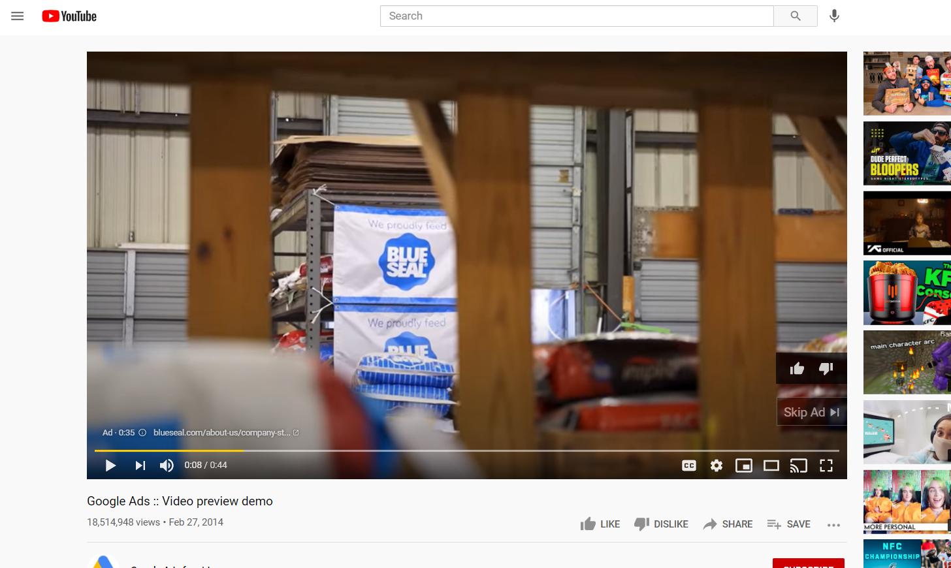
Video Marketing
One of the top video campaigns we continue to see increasing success within the Home Improvement industry is YouTube TrueView
Use product/service-specific or general branding video ads to target specific audiences in specific zip codes
With direct access into the platform we can easily pause, activate, and swap videos according to seasonal fluctuations, video updates, or market trends
Views are only chalked up to “completed” when the video is played through to :30 or played through its entirety – whichever is achieved first – and you only pay for completed views
The platform determines who should see the videos according to users’ overall search behaviors, not just the content users have searched for on YouTube
In most cases, YouTube advertising can be submitted for co-op reimbursement
Measurable KPIs:
Impressions
Clicks & CTR
Completed Views & View Rate
Avg. Cost per View
Views to 25%, 50%, 75%, & 100%

Slide 14
WITH MASSLIVE MEDIA
Industry Experience
Seasonal Flexibility
Consistent Campaign Optimization
Campaign Performance Reporting

Slide 15

MassLive Media
MassLive Media works with more than two dozen home improvement retailers annually, enabling us to make strategic marketing recommendations based on our capabilities, experience, and marketplace knowledge.
We know that spring doesn’t always start in March and end on Memorial Day, and sometime winter starts before Thanksgiving and ends right after Christmas. Our campaigns allow us to be seasonally flexible in order to accommodate not only the weather, but the seasonal fluctuations you experience with your customers.
Our campaigns, and the platforms on which we run them, grant us access insights on several different fronts. From consistent campaign monitoring and optimization to providing campaign performance reports – we’re able to detect optimization opportunities at every turn to ensure that your campaign is maximizing your ROI.

Slide 16
LET’S GET STARTED!
Name
Title
Email
Phone

