Slide 2
Pediatricians
Hospitals
Private Practices
Dentists
Surgical Oral Care
Home Health Care
Chiropractors
Eye Care
Higher End Spas
Health Care Insurance Providers
Dermatologists
Physiatrists
Physical Therapy
Wellness
Fitness and Trainers
Holistic Health
Cannabis Industry

Slide 4
While in 2020 many healthcare organizations saw their financial plans obliterated, patient behaviors radically shift and virtual care explode, in 2021 they will work to put the system back together,” said PwC researchers. “Not to how it always was – but in a way that reimagines healthcare delivery, reconnects broken pathways and makes a giant leap toward a consumer-centric healthcare system.”
"Nearly overnight, as volumes dropped precipitously, the deadly pandemic thrust patients, doctors, pharmaceutical companies and payers headfirst onto virtual platforms and other digital technologies."

Slide 5
Healthcare marketing strategy is used to support the practices of in-person healthcare providers and telemedicine providers. ... In 2021, a healthcare marketing strategy can take many different forms and span multiple channels to target the right patients at the right time and in the right way.

Slide 8
#1 Healthcare Content Marketing
It is essential tactic to include in your healthcare marketing strategy. It allows your practice to educate potential patients through engaging, relevant, and informational content. This content can come in the form of a blog on “how to choose the right healthcare provider” or a longer, more in-depth eBook on a certain condition that your practice specializes in. No matter what type of content you’re creating, the goal is to provide relevance and value for your leads.

Slide 9
2. Evaluate the online patient experience
A decade ago, simply having a website was enough to impress prospective patients and help them find your healthcare brand identity. But now, a website is healthcare’s new front door. It’s the first thing patients often see, and if it’s not optimized for user experience, it may also be the last time a person considers your hospital or healthcare practices.
Put yourself in a patient’s shoes. If someone were to land on any page of your site, would they know your practice’s location, or your medical practices‘ multiple locations, and primary services in about 5-10 seconds? Would they be able to contact the right person quickly? Do the imagery and wording represent your healthcare clinic’s, or practice’s, average patient?
User experience is an important consideration in website design. But sometimes, designers are so focused on making the website look good, they forget to focus on the patient experience. We often find that websites need to be completely redone. However, it might help to make small changes, like positioning the “Contact Us” form higher up on the page.

Slide 10
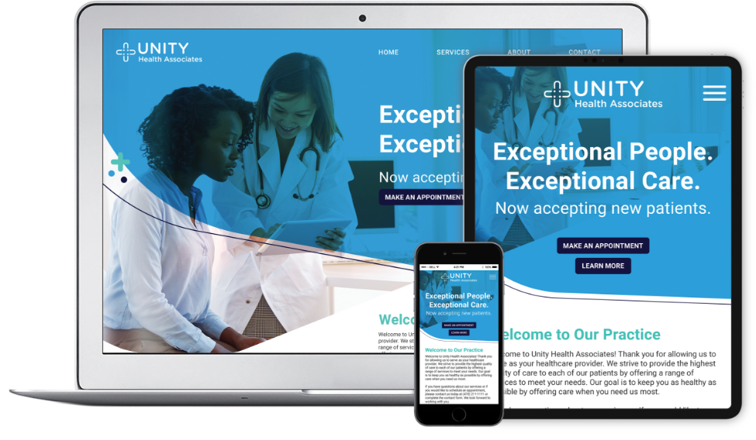
#3 Build a responsive healthcare website
A responsive website is one that automatically adjusts to the size of a screen, so the experience is the same whether the site is accessed on a computer, tablet, your phone, or any mobile device. It’s the norm [FYI: Google will mobile-first index all websites, including Healthcare websites, by September 2020 in website design today–but more than that, it’s something search engines are looking for when crawling any medical website to determine how and where you’ll rank.
Google cares about the user experience, and it will prioritize competitors who have a site optimized for mobile users. In general, responsive sites work best for the mobile digital healthcare experience. But even if you currently have a responsive site, you should check that the both your content and imagery continue to load properly (and promptly!) on mobile devices.

Slide 11
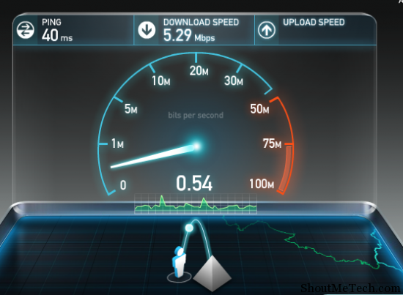
#4 TEST SITE SPEEDS
Healthcare marketers who study user (prospective patients) behaviors online have proven that patients today are less willing to put up with slow loading times than ever before. It only takes 5 seconds to lose a prospective patient who decides to navigate elsewhere to their healthcare thanks to your slow site.
In fact, it’s another user experience (or patient experience) issue that may cause your medical or healthcare website to fall in the search engine results. You can test your site speed at Google’s PageSpeed Insights here. If load times are slow, speak to your web developer about ways to speed it up. And, another healthcare marketing tip, to remember — check the site speeds of your competitors, within your “healthcare neighborhood”, or within you medical services niche.

Slide 14
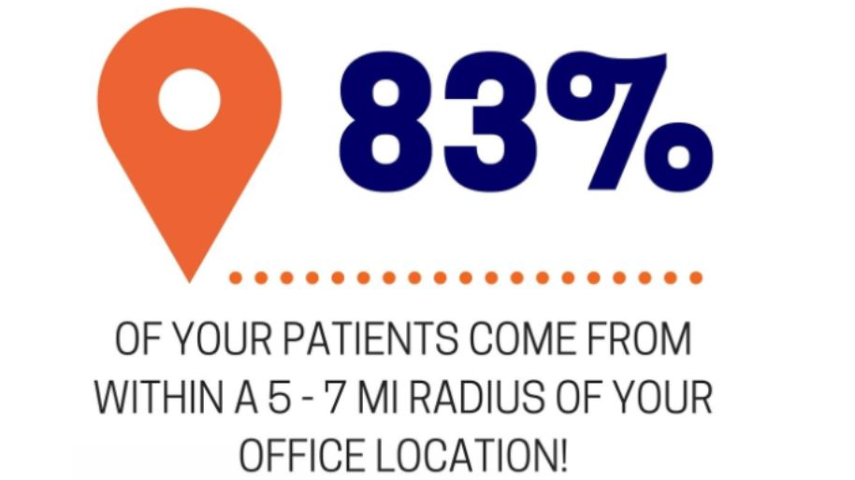

Slide 17
https://www.healthgrades.com/blog/2021-health-observances-calendar

