Slide 1

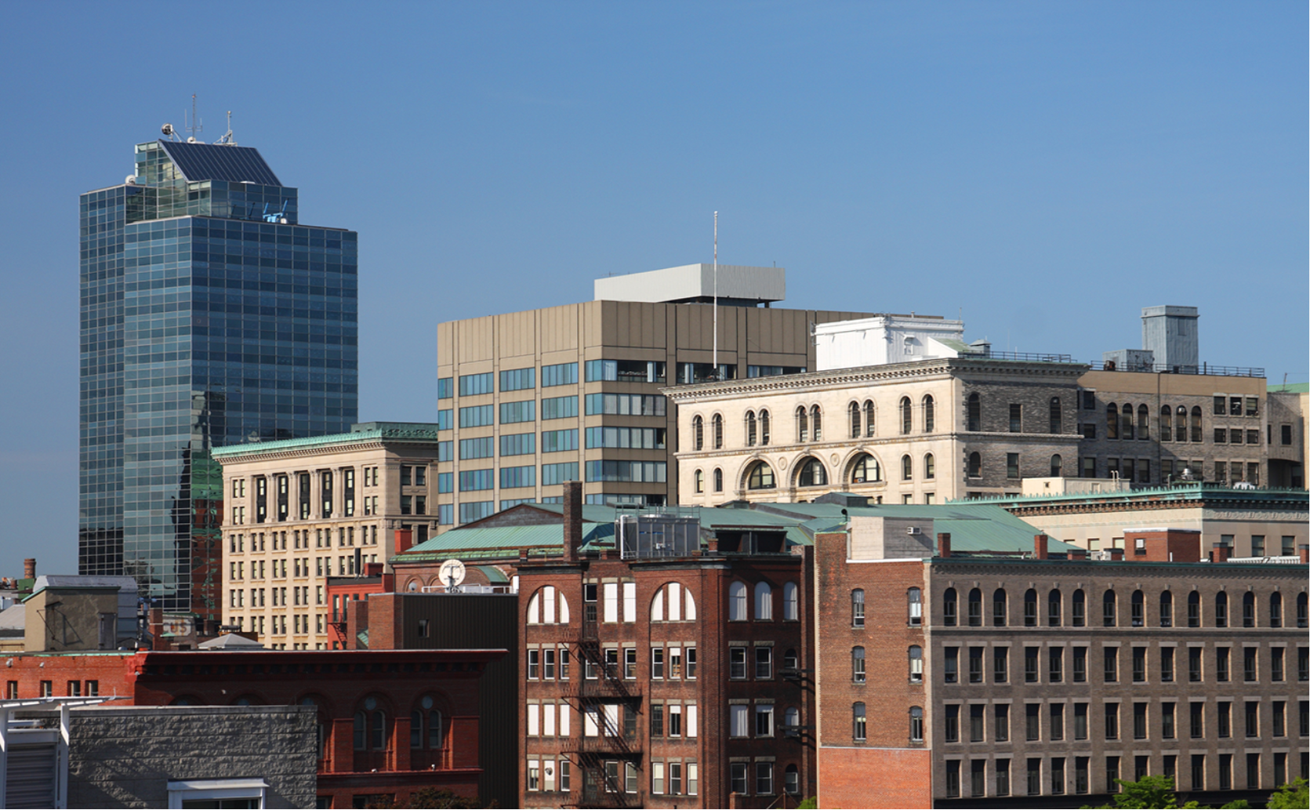

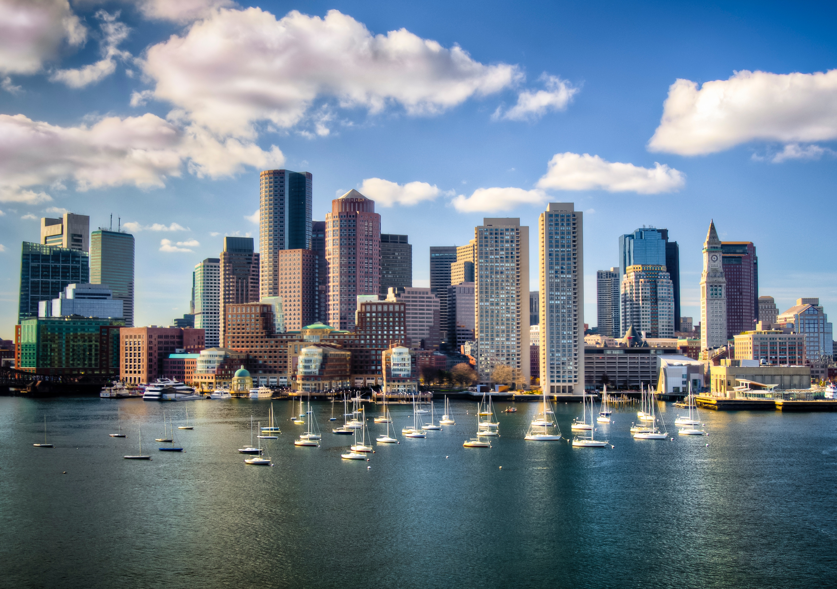
Byron Z. Jones
Digital Media Strategist
413.478.7345
Bjones@masslive.com
Higher Ed Insights
Notes:
Update the photo on the left for the Worcester office once construction outside subsides. Dan Adams may be able to shoot with drone.

Slide 2

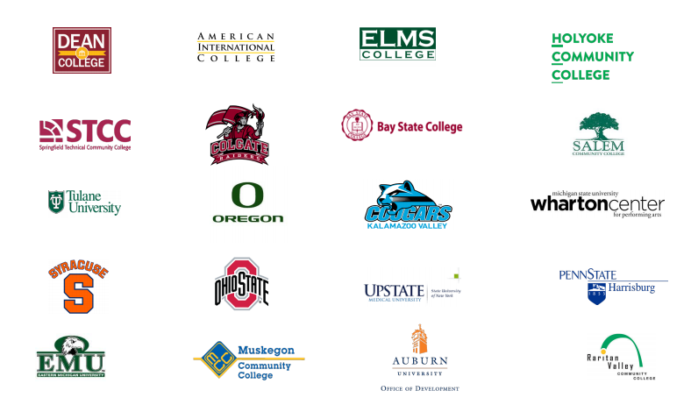
There are more than 250 colleges and universities in New England, ranging from schools of theology, business, and art to doctoral universities with the highest research activity in the nation
There are 82 four-year colleges and universities in Massachusetts enrolling 396,400 students.
Boston is the location for 35 colleges, universities, and community colleges.
There are 68 private colleges and universities in Massachusetts.
Notes:
Make Reddit logo bigger

Slide 3
The final word is that, overall, college enrollments declined 2.5 percent this past fall. This is twice the rate of decline reported in fall 2019. Higher education lost about 400,000 students this fall.
Community college enrollment saw the sharpest declines, and freshman enrollment is down 13.1 percent, about steady with the previous report. Community college enrollment is down 10.1 percent, up from the 9.5 percent decline in the last report. Public colleges over all lost 4 percent of their enrollment, a concerning fact given public institutions enroll seven out of 10 students.
Notes:
Make Reddit logo bigger

Slide 4
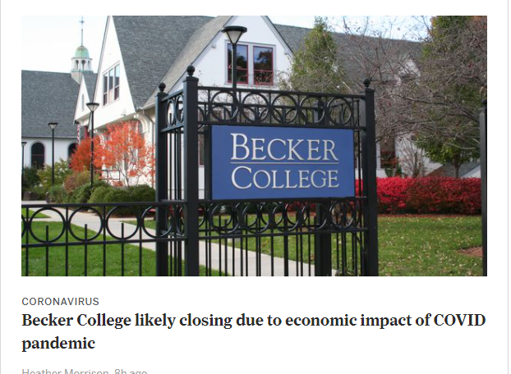
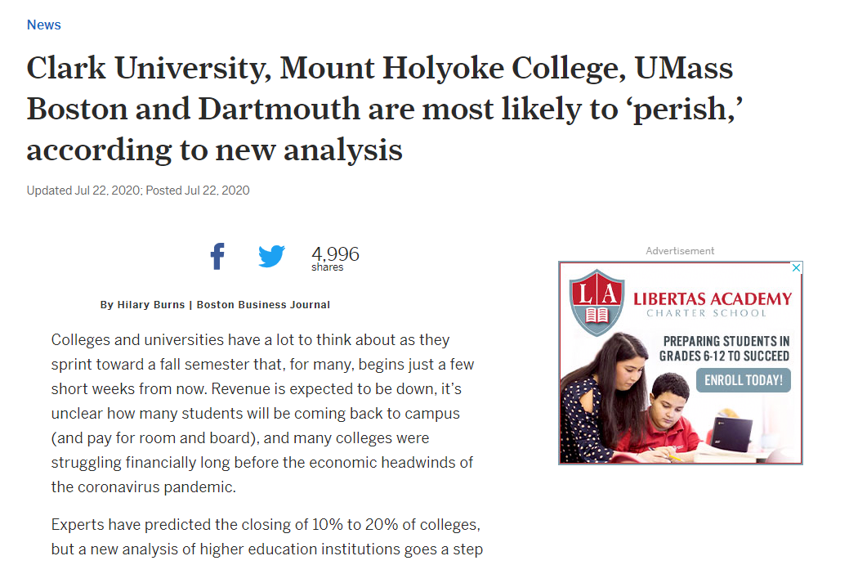
Trouble in the World of Higher Education
https://www.masslive.com/coronavirus/2021/03/becker-college-likely-closing-due-to-economic-impact-of-covid-pandemic-has-stopped-all-recruiting-activities.html
https://www.masslive.com/news/2020/07/clark-university-mount-holyoke-college-umass-boston-and-dartmouth-are-most-likely-to-perish-according-to-new-analysis.html
Notes:
Make Reddit logo bigger

Slide 5
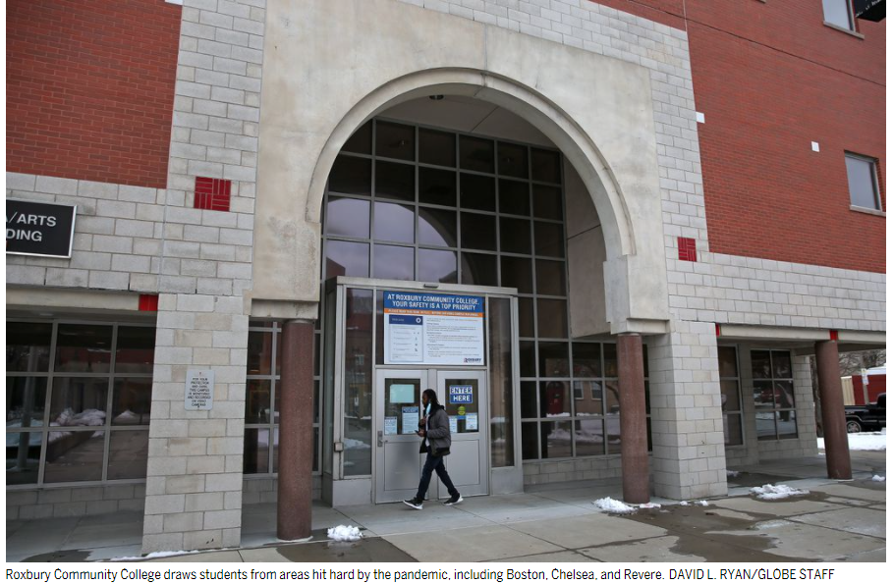
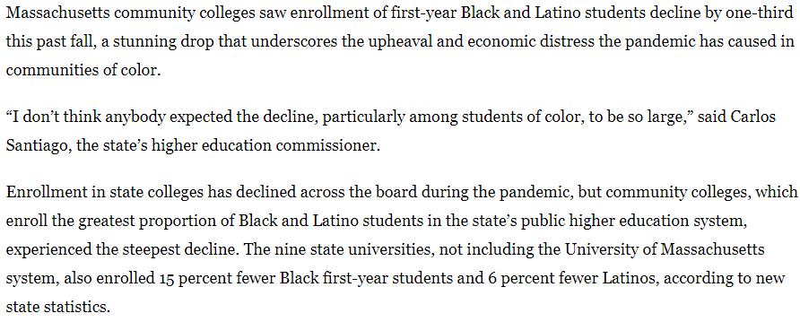
Black and Latino enrollment plummets at Massachusetts community colleges
https://www.bostonglobe.com/2021/02/04/metro/black-latino-enrollment-plummets-massachusetts-community-colleges/?s_campaign=breakingnews:newsletter
African American | 3064
Spanish Language Speakers | c0834
Hispanic | 3065
Higher Education intent/interest | c0220

Slide 6
Understanding
Yield
Colleges are constantly working to increase their yields and thus increase tuition revenues. A higher yield also makes a college more selective. If a school can get 75% of admitted students to attend rather than 40%, then the school can admit fewer students.
“Yield protection (commonly referred to as Tufts syndrome) is an admissions practice where a university or academic institution rejects or wait-lists highly qualified students on the grounds that such students are bound to be accepted by more prestigious universities or programs.”
School | Class of 2020 Yield | Class of 2019 Yield
Harvard University | 80% | 81%
MIT | 74% | 73%
Princeton University | 68.5% | 67.7%
Colleges Report Matriculation for the Class of 2020

Slide 7




Top Higher Ed Accounts 2020 Closed Verified Spend
American International College – $164,231.98 (2010)
Elms College - $81,710.01 (2004)
Westfield State $29,000 (2016)
Springfield Technical Community College $20,600 (2007)

Slide 8
Top Higher Ed Accounts 2020 Closed Verified Spend
AIC
2020 compared to 2019 – 22% increase in organic traffic (brand awareness)
2019 compared to 2018 – 15% increase in organic traffic
2018 compared to 2017 – 11% increase in organic traffic
Elms
2020 compared to 2019 –Paid search traffic up 116% driving a 29% increase in goal completions.
2019 compared to 2018 – 8% increase in organic traffic
Westfield State
Brought goal completion rate up to 5.22% from 3.06% when we first started measuring goals
STCC
Brought online application submission rates up to 1% from .77% when we first started measuring conversions

Slide 9
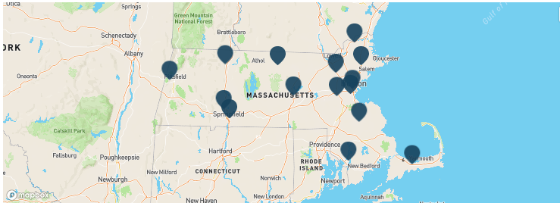
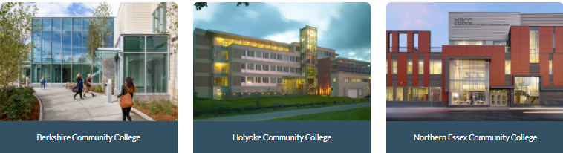
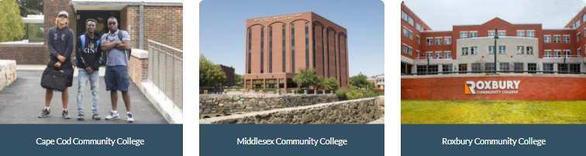
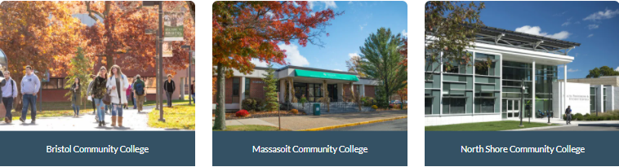
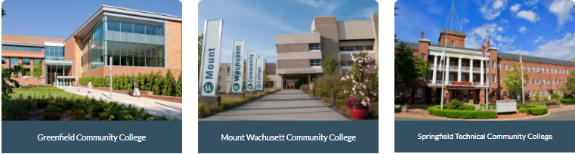
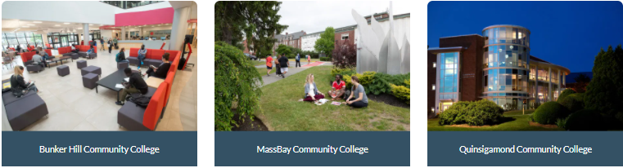
Massachusetts has 15 Community Colleges, each with multiple campuses and satellite locations that offer unique opportunities for the local communities they are a part of. Each college provides open access to high quality and affordable academic programs.
Notes:
Make Reddit logo bigger

Slide 10
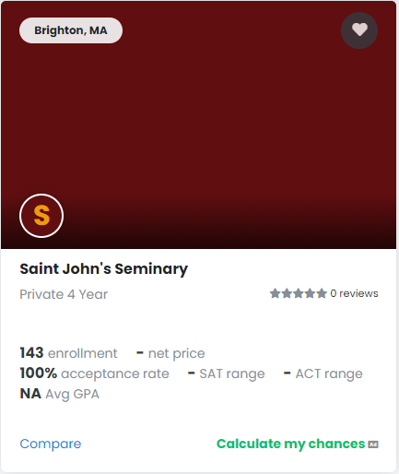
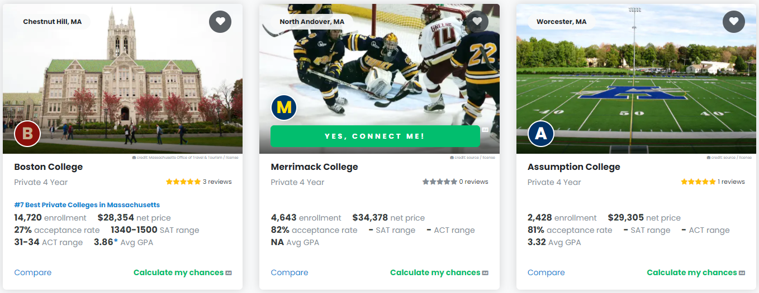
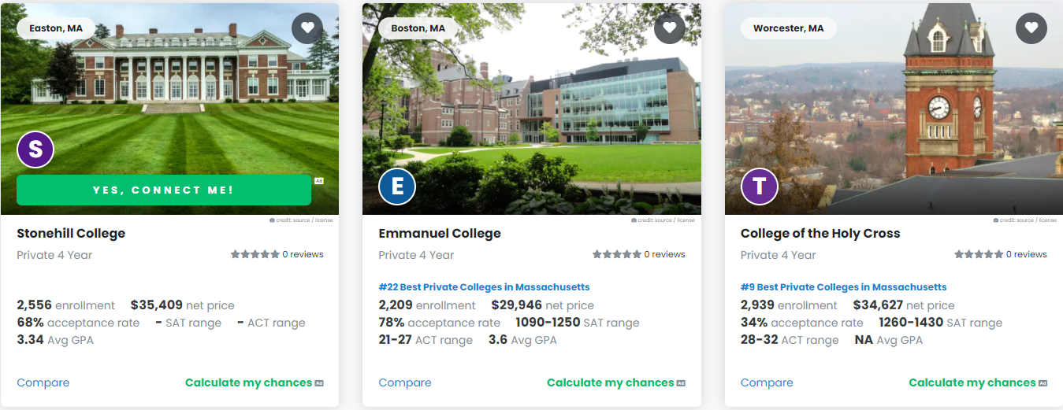
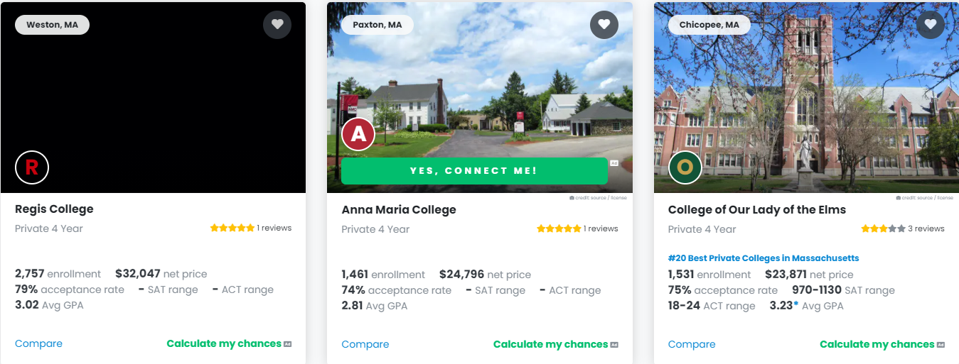
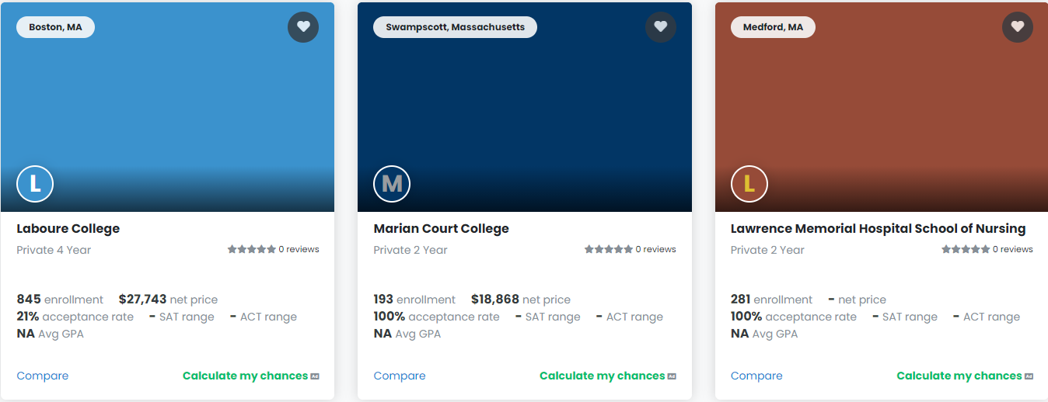
Massachusetts Catholic Colleges
LIST OF CATHOLIC COLLEGES AND UNIVERSITIES IN MASSACHUSETT

Slide 11

Montage Video Higher Ed.

Slide 12


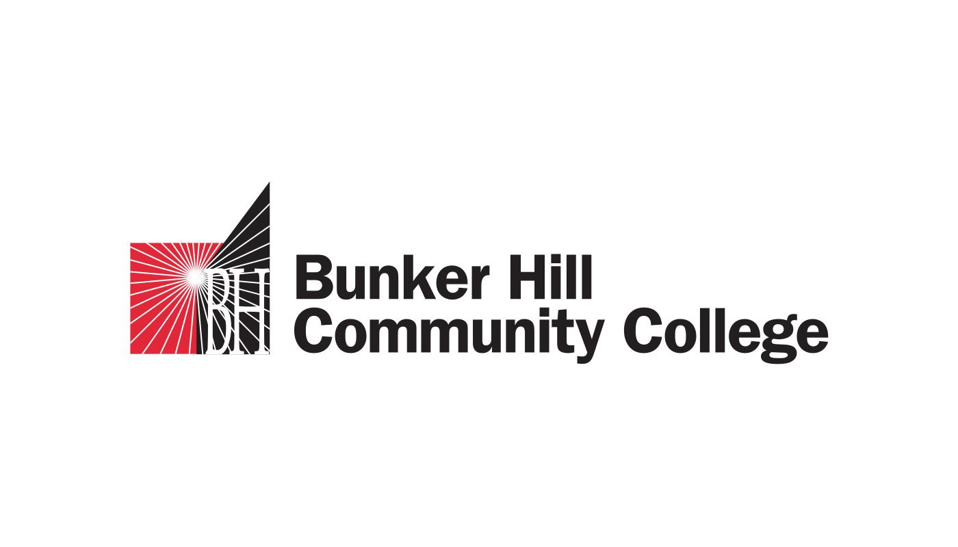
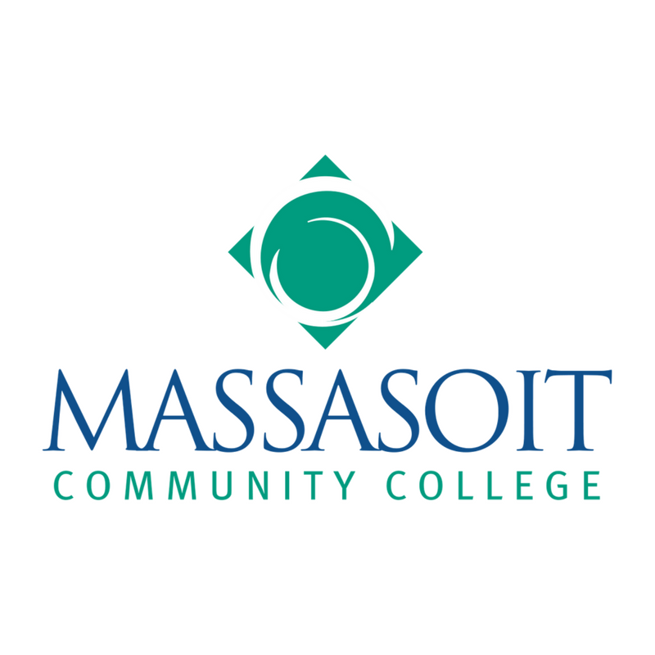


Public Higher Education Campuses
Community Colleges
Berkshire Community College, Pittsfield
Bristol Community College, Fall River
Bunker Hill Community College, Boston
Cape Cod Community College, West Barnstable
Greenfield Community College, Greenfield
Holyoke Community College, Holyoke
Massachusetts Bay Community College, Wellesley Hills
Massasoit Community College, Brockton/Canton
Middlesex Community College, Bedford/Lowell
Mount Wachusett Community College, Gardner
North Shore Community College, Danvers
Northern Essex Community College, Haverhill
Quinsigamond Community College, Worcester
Roxbury Community College, Roxbury
Springfield Technical Community College, Springfield
State Universities
Bridgewater State University, Bridgewater
Fitchburg State University, Fitchburg
Framingham State University, Framingham
Massachusetts College of Art and Design, Boston
Massachusetts College of Liberal Arts, North Adams
Massachusetts Maritime Academy, Buzzards Bay
Salem State University, Salem
Westfield State University, Westfield
Worcester State University, Worcester
University of Massachusetts
Umass Online
University of Massachusetts System Office
University of Massachusetts Amherst
University of Massachusetts Boston
University of Massachusetts Dartmouth
University of Massachusetts Lowell
University of Massachusetts Medical School
Notes:
Make Reddit logo bigger

Slide 13
Higher Ed Impression Estimates
Mass Education Intent
3064 African American – 2.08 million
c0834 Spanish Language Speakers – 2.16 million
3065 Hispanic – 2.22 million
c0257 Hispanic parents – 1.98 million
c0220 Higher Education Intent/Interest – 2.34 million
c0568 college grads interested in grad school – 1.53 million
6353 age 18-24, high school grad or some college, not a college graduate of any level – 508,000 impressions
c3132 high school or associates or bachelor’s, no master’s or higher – 2.09 million
c0473 parent of teenager, or teenager – 2.26 million

Slide 14
