Slide 1
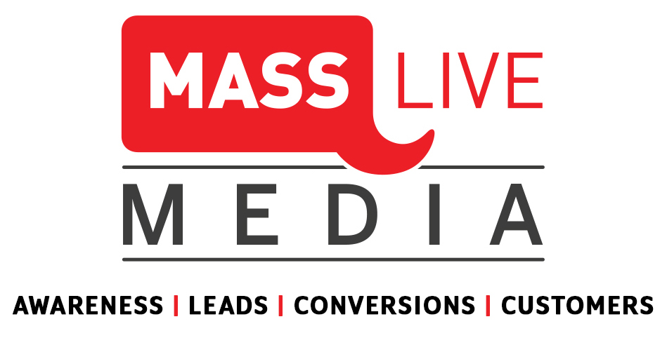
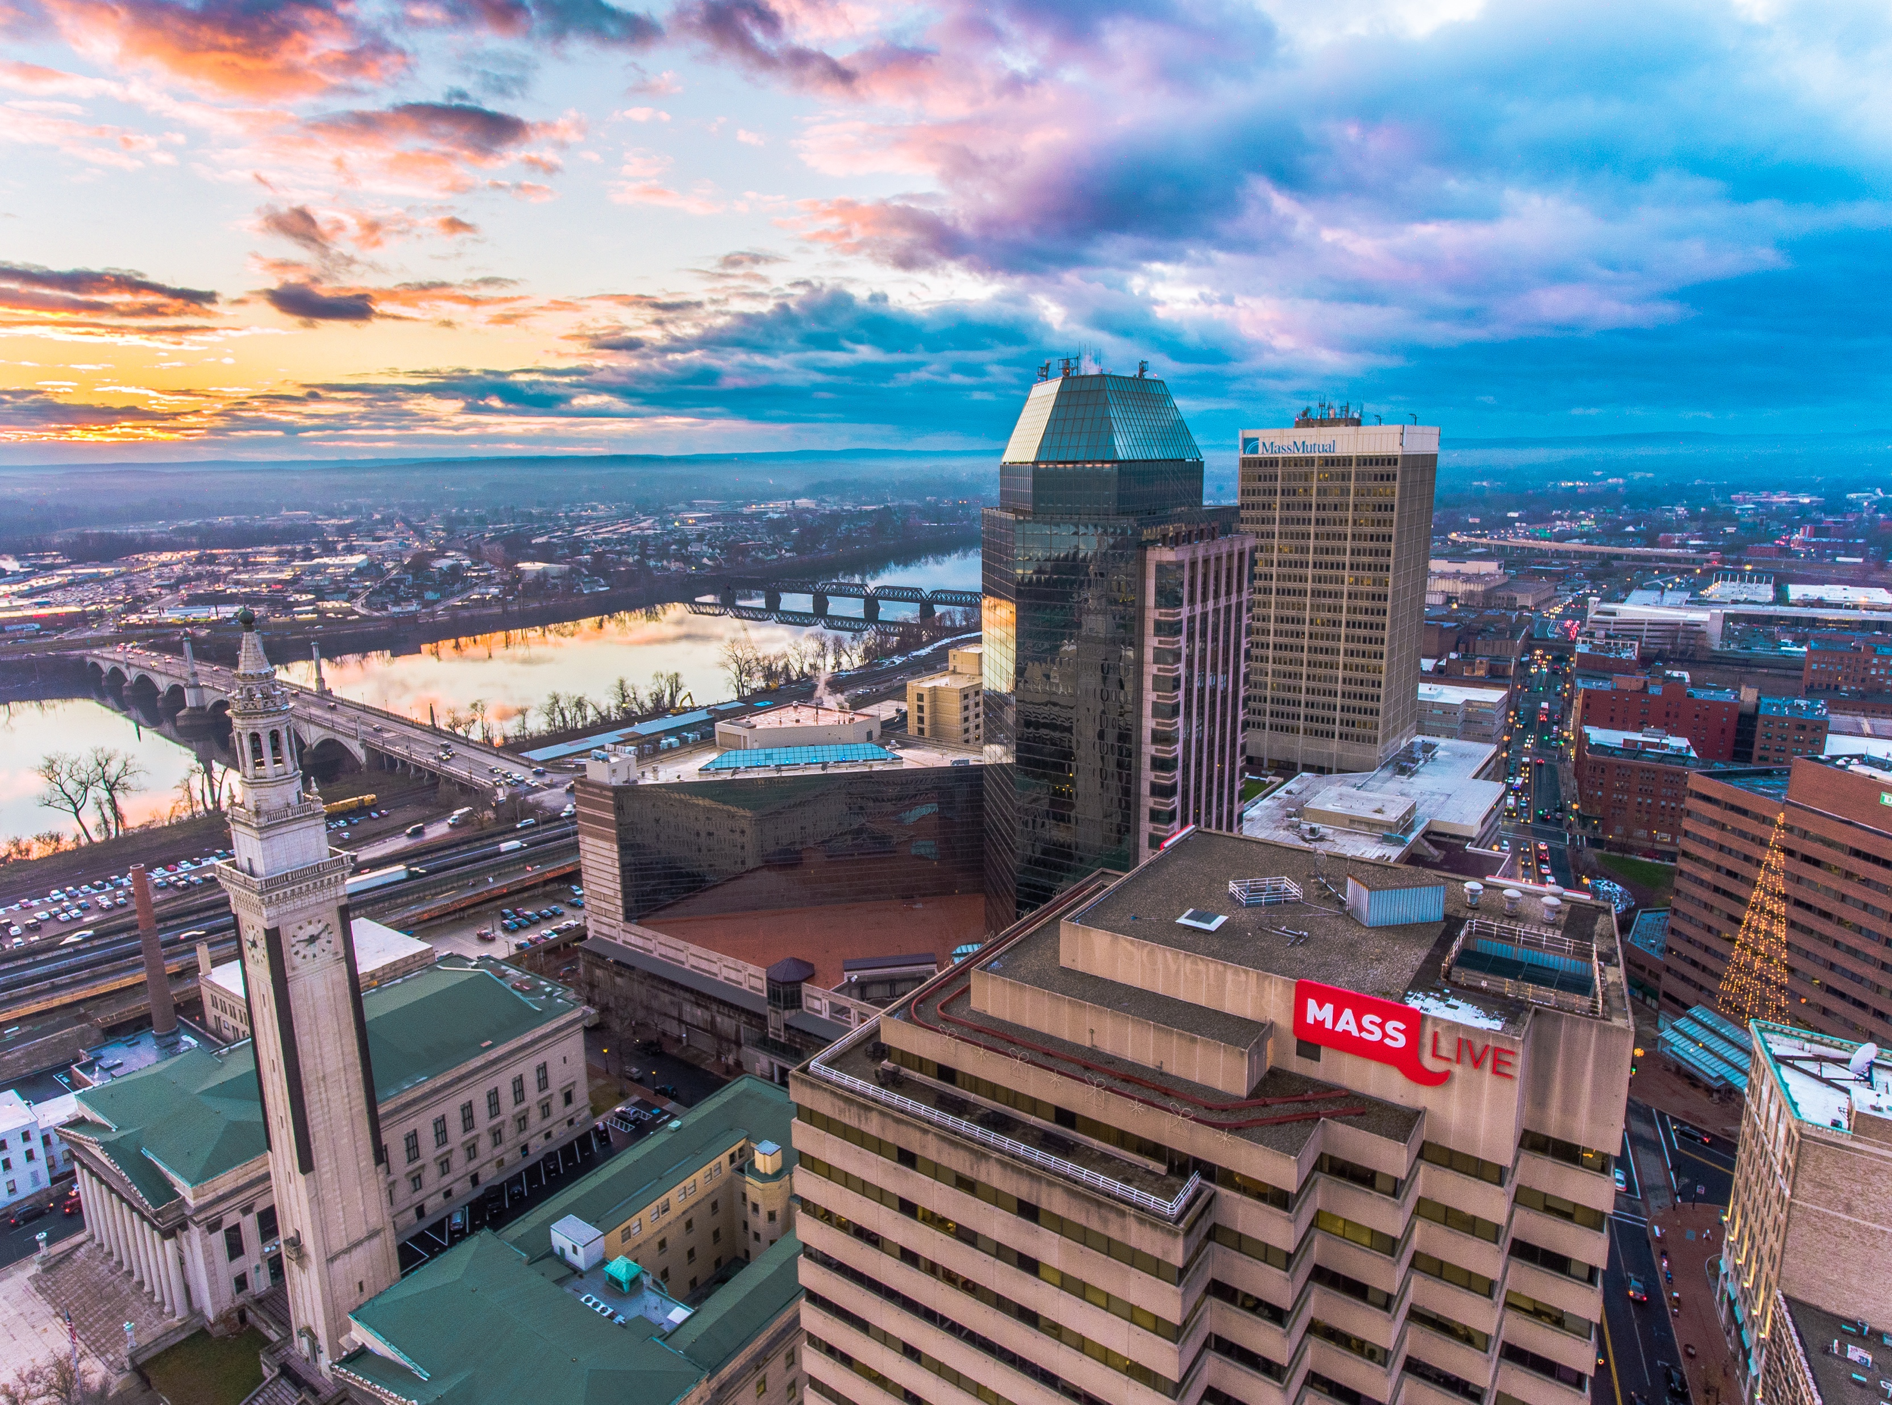
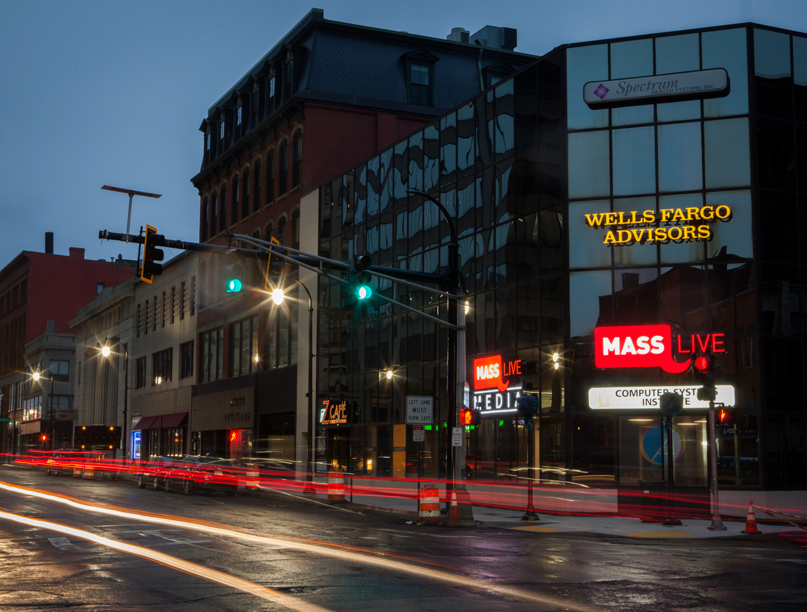

SOLUTIONS DECK
Notes:
Will update with new pic of Worcester office

Slide 2

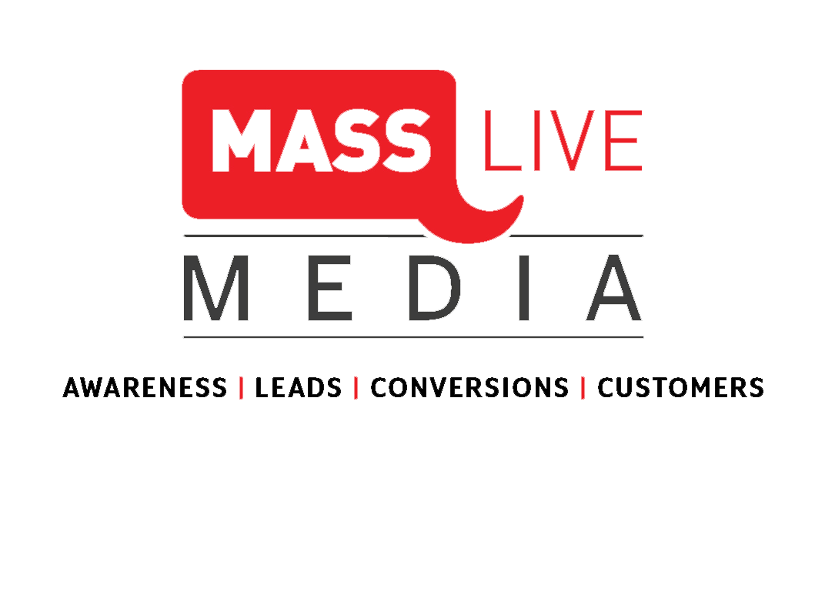
DISPLAY ADVERTISING
Measurable KPI’s:
Impressions
Clicks
Click-through rates

Slide 3



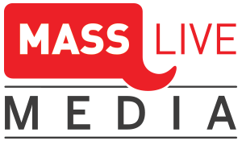
WHY ONLINE?
Brand
Brand
Digital allows For Specific Targeting & Minimal Waste
Brand
Brand

Slide 4
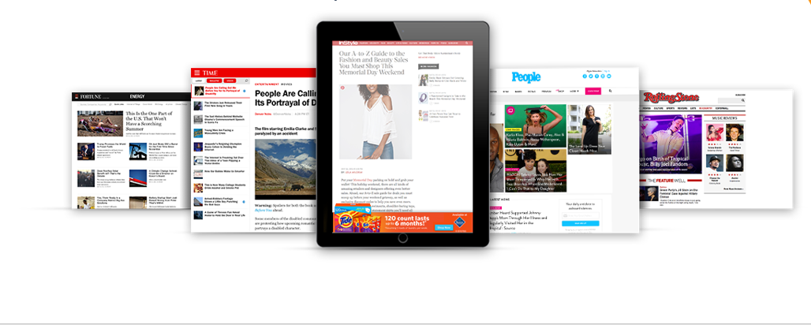
WHY DISPLAY?
Over
95% of online time is spent on content sites
Be where your audience is spending their time

Slide 5


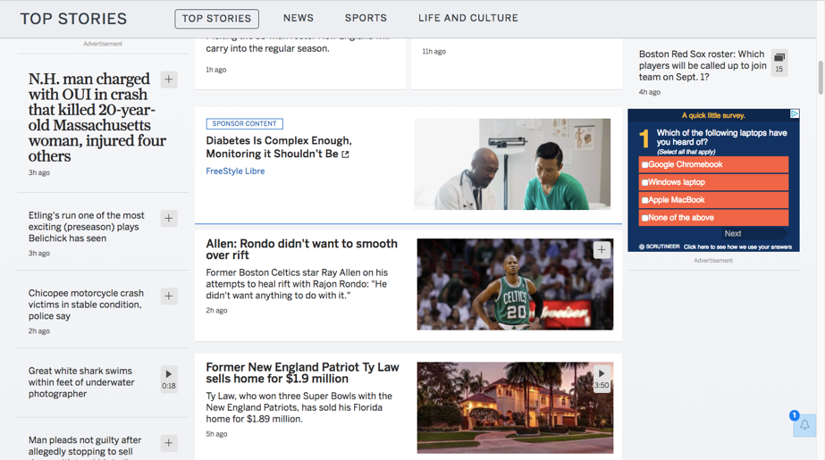

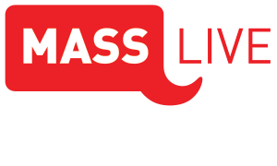
MASSLIVE DISPLAY- HIGH IMPACT AND ADHESION
High impact ads are exactly as they seem – impactful.
With adhesions, the ad remains visible on the bottom of a viewing screen while scrolling the MassLive.com website.

Slide 6

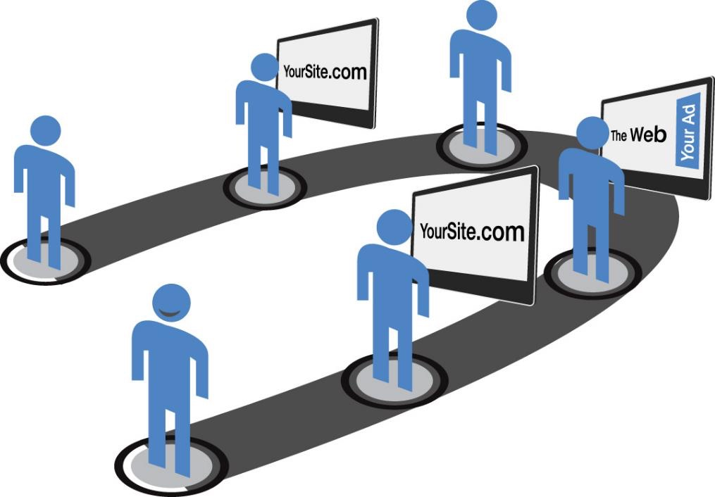

EXTENDED NETWORK DISPLAY- RE-MESSAGING
2
They visit your site
3
But leave
without converting
1
Potential customer
Your ads recapture
interest bringing them back to your site
4
Ads are then served to you as you browse the internet
Re-messaging should
be part of every marketing campaign
to maintain top of mind
brand awareness to those who
have visited your site
Your ads recapture
interest bringing them
back to your site
5
6
Potential customers
turn into happy customers

Slide 7
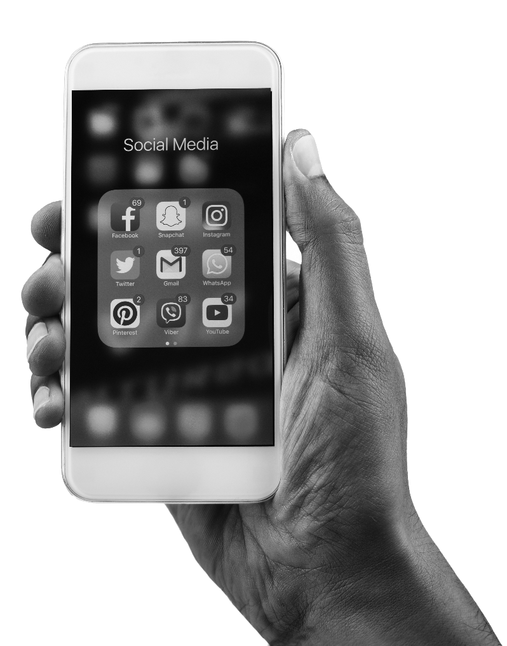




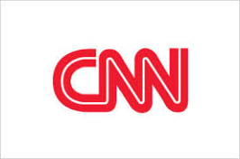


NETWORK DISPLAY
When we serve ads on our extended network you are still using our valuable data
This tactic works better than programmatic ads and Google ads
Ads can appear on thousands of brand-safe sites – and on any device
10B+ ads per month delivered across our partnered network

Slide 8
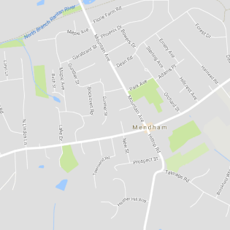

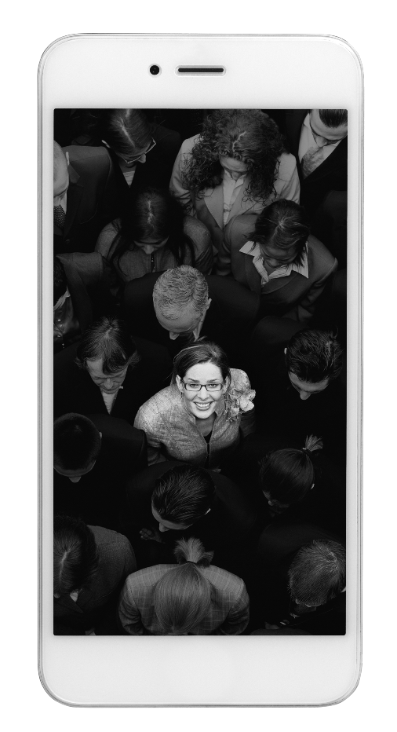
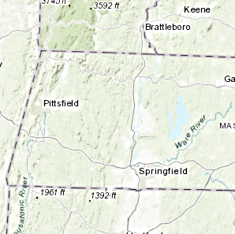


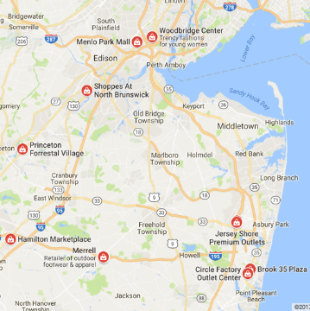
PINPOINT AUDIENCES (GEOFENCING)
Proximity-based targeting + mobile intelligence to target those most likely to take action, then deliver more relevant ads and experiences.
Real-time targeting based on location:
  Deliver messaging in real-time to consumers within a specific location relevant to your business.
Geo-retargeting based on location profile:
  Capture device ID’s and message users based on their past location, no matter where they happen to be next.
Notes:
GeoAudience
Who You Are
Home neighborhood demographic profiles and spending patterns
GeoFences
Where You Are
Proximity-based targeting
Competitor conquesting
Geo-Retargeting
Where You’ve Been
Real-world retargeting based on historical location data
Mobile profiles based on historical transaction data

Slide 9
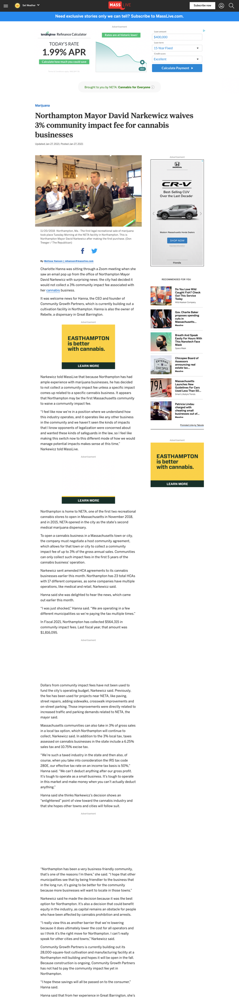
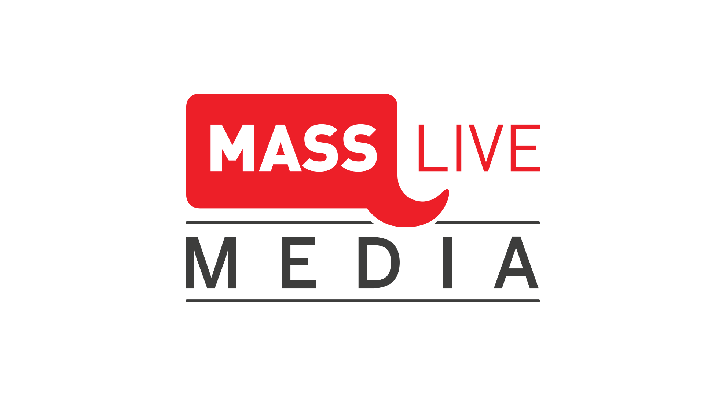
NEWS SPONSORSHIP ON MASSLIVE.COM
Exclusive opportunities for your brand
Article level sponsorships include a text call-out of the single sponsoring brand on all news content within that category.
The text links to your web page or social and receives 100% share of voice and 100% viewability on that content category.
Content sponsorships include MassLive’s coverage of the Celtics, Red Sox, Patriots, news categories such as Marijuana or Casinos, High School Sports, and many more! Let readers know your brand is making this coverage possible.

Slide 10
VIDEO ADVERTISING
Measurable KPI’s:
Quartile completion rate
CPV (TrueView)
New users
Assisted conversions
Engagement

Slide 11
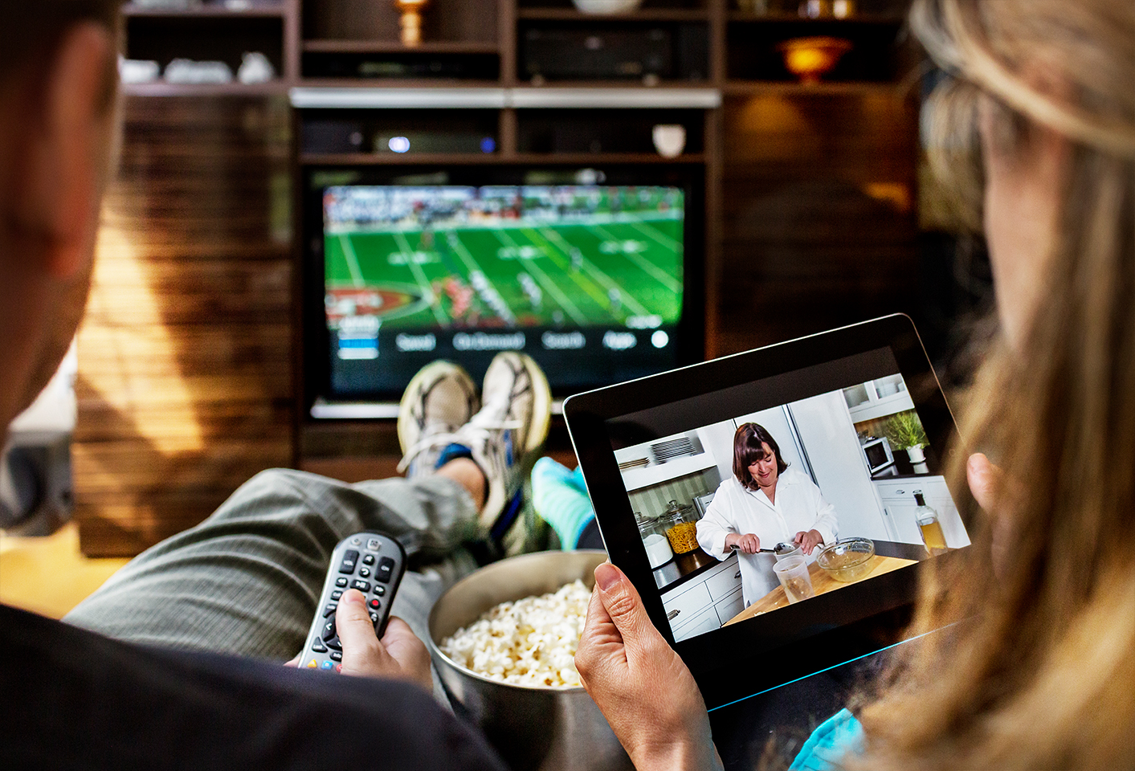
Changing Habits- TV Multi-Tasking
75% multi-task while watching TV
Less than half of our TV viewing time is spent “Live TV” watching.
81% of adults multitask with a 2nd device while watching TV.
33% Do so to continue to be entertained or communicate with friends and family | 82% Liked to multi-task while watching TV because it made them feel productive
82% Check email during TV shows or during commercials | 71% Visit social media platforms during commercials, 70% during shows
85% Visit Facebook, among those using social media when multi-tasking | 41% Stated seeing a TV ad made them interact with the brand online
82%
Check email during TV shows or during commercials
41%
Stated seeing a TV ad made them interact with the brand online
1
Source: Millward Brown, Survey Sample n500

Slide 12
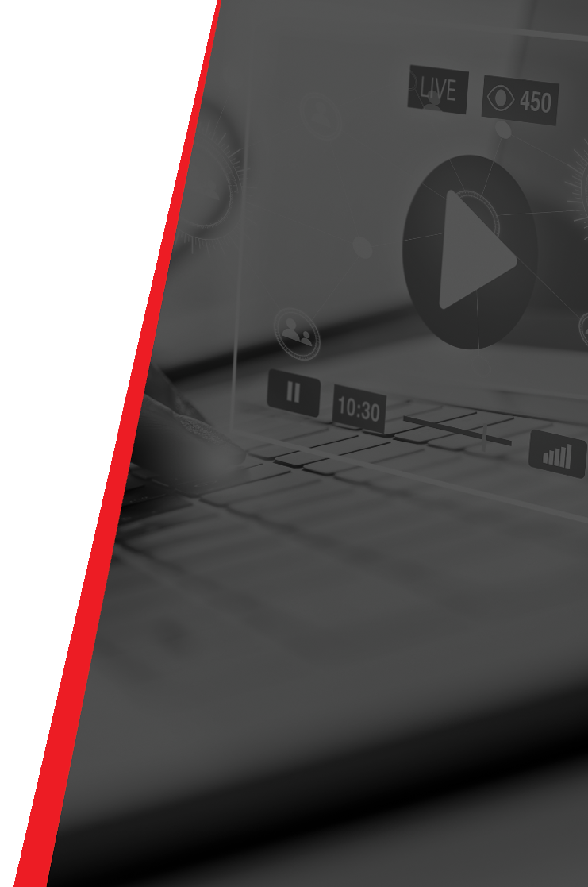
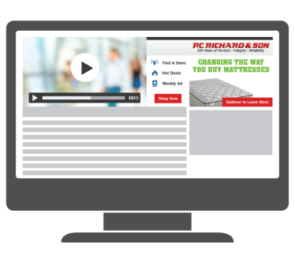
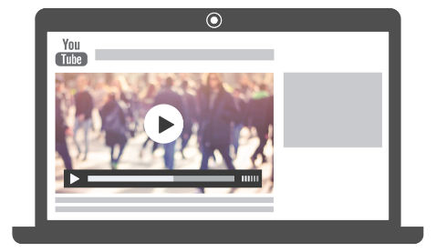
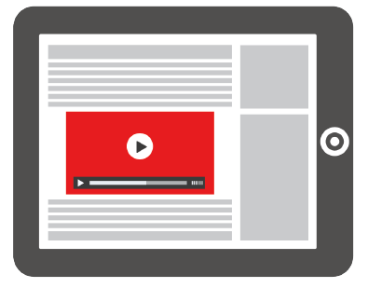
VIDEO SOLUTIONS
In-Banner Video plays inside a display ad with additional engaging features such as social sharing, survey forms, add to calendar, maps and directions, live RSS feeds and more.
YouTube Video delivers your pre-roll video across the YouTube network with superior targeting capabilities.
In-Story and Native Video feature your videos within the editorial content on Masslive.com
54

Slide 13
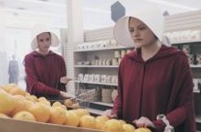
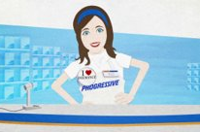
OTT VIDEO
Over-the-Top video ads are delivered on any app or website that provides streaming of broadcast and/or full episode content over the internet device targeted to a television screen​, leveraging our 1st and 3rd party data to target your desired audience.
Desired content
Targeted Video Ad​
Return to desired content​
User is watching live TV or Full Episode premium content on their Smart TV or Connected Device such as a Roku or Apple TV.
Mid content non-skippable advertisements are loaded and served to the user. This can range from a single ad to several.
Once the advertisements have completed, the originally desired content resumes.
54

Slide 14
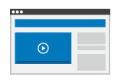
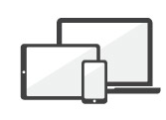
VIDEO WITH VERSATILITY
Maximize the impact of your video content
Think beyond pre and post-roll with our Responsive Rich Media Video Solutions that delivers your video content to your target audience
Multi-Format Multi-Screen
Create and run in-stream , in-app, or in-banner video ads
Create and deploy on any device – desktop, tablet, or phone

Slide 15



YOUTUBE REACH ACROSS THE US
1.9 billion active users
Average viewing session +50% year-over-year
5 billion videos watched per day
1 billion hours of video watched per day
Pause here to think whether your audience needs this information

Slide 16
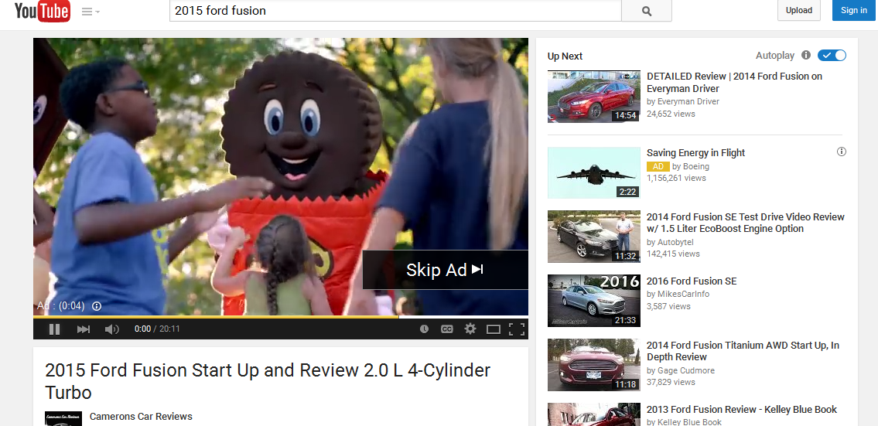
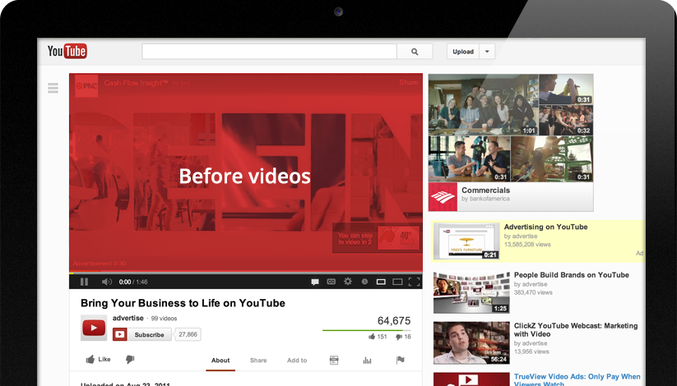
TRUEVIEW: SKIP OPTION AND COMPANION ADS
Reach the right customer for your business by targeting keywords, demographics, content, and more. Plus, your ad is skippable after 5 seconds and you pay only when a user engages with your ad or watches to completion.

Slide 17
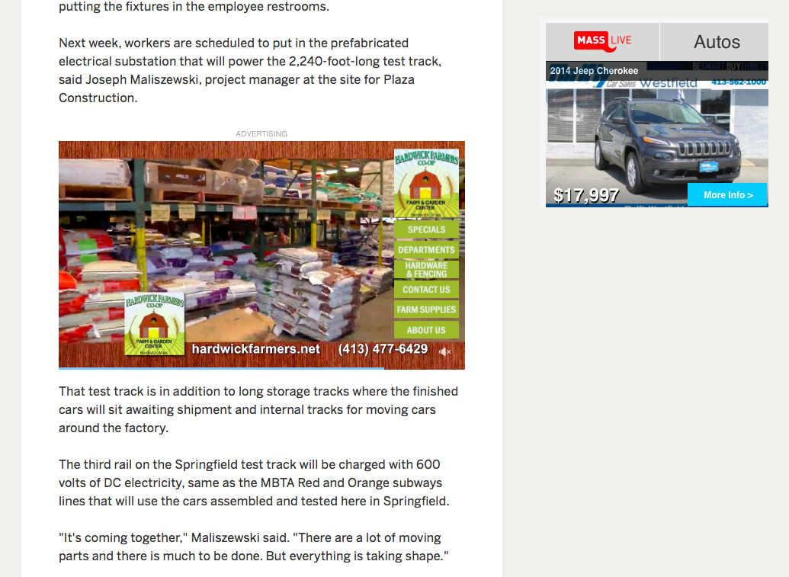
IN-STORY VIDEO ADS
Video ads serve within our premium content/article pages where readers are most engaged.
Video will play once it is viewable on the screen, and pause when less then 50% visible on page
More targeting options than ever before: Content, Geographic, and Behavior.
Less intrusive than standard pre-roll video ads.

Slide 18
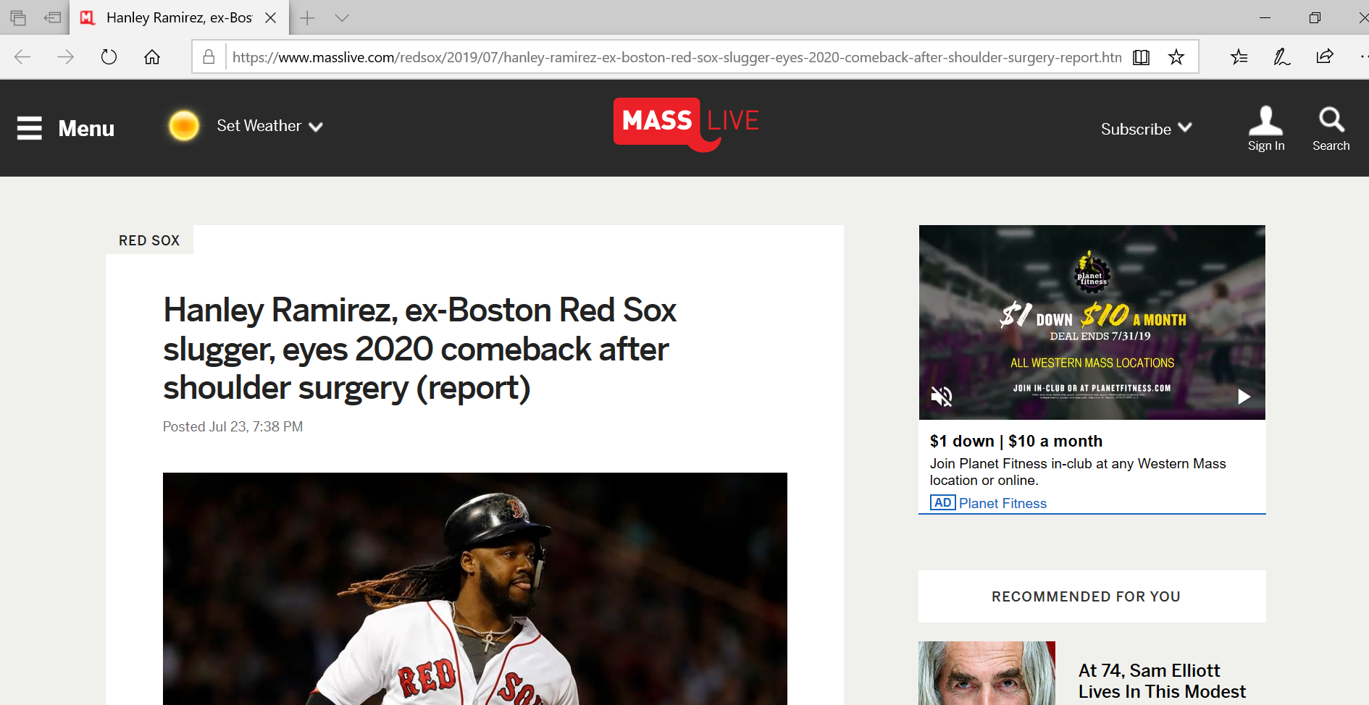
MASSLIVE DISPLAY- NATIVE VIDEO WITH CONTEXT
Native display is advertising that matches the interface of the platform where it appears.
Includes sponsor articles, in-stream content, and social media advertising
Advertiser is able to add context to their video by adding a headline and description, much like a social ad
The video will auto play (without sound) when allowed by the browser

Slide 19
CONTENT MARKETING
Measurable KPI’s:
In-stream impressions
Clicks to article pages
Engagement metrics

Slide 20
“Other than peer influence, content is one of the biggest factors that can have an impact on the buyer’s path to purchase.”

Slide 21
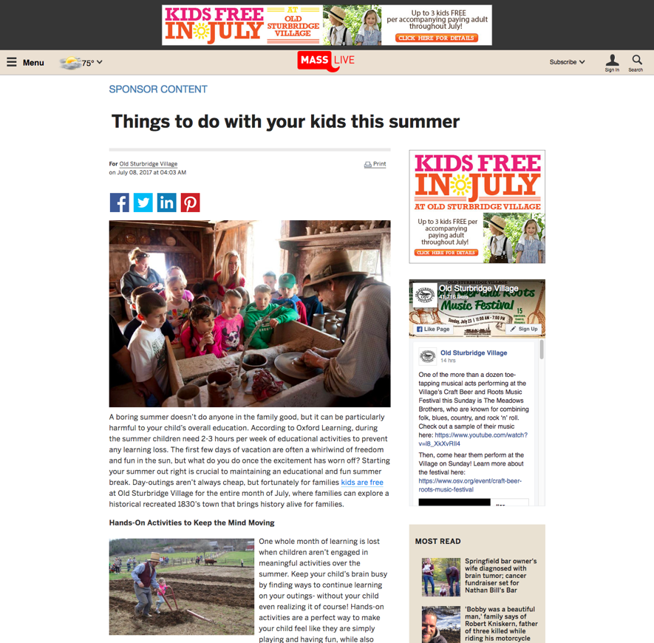
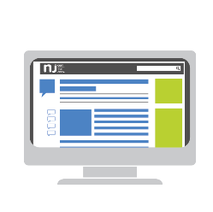
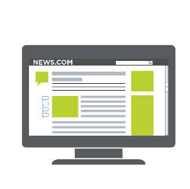
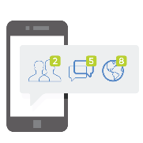
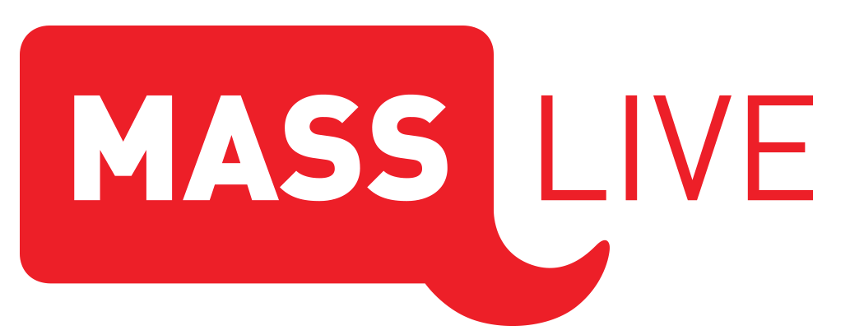
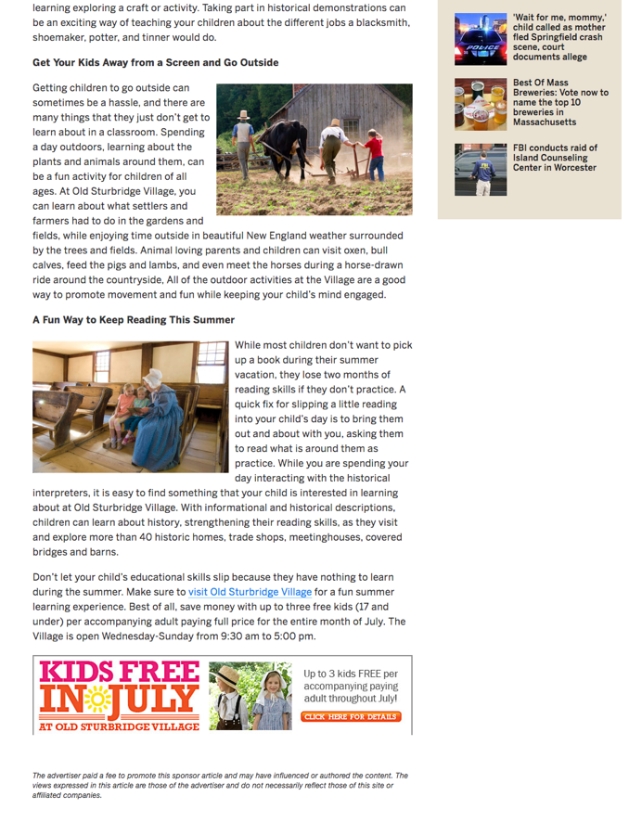
SPONSOR CONTENT- ENGAGING AUDIENCES
Advertiser content delivered across channels, refined audiences and geographies.
MassLive.com
Network
Social
Sponsor stories include:
  500-1000 word articles
  Fixed ad units on the article page
  Sponsored links to your website
  Strategic keywords to maximize organic search

Slide 22
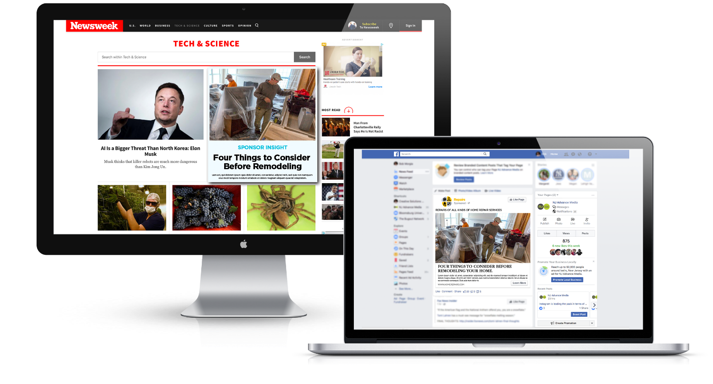
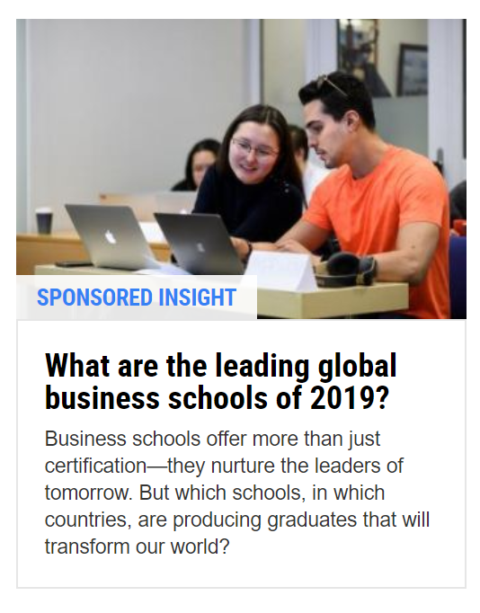
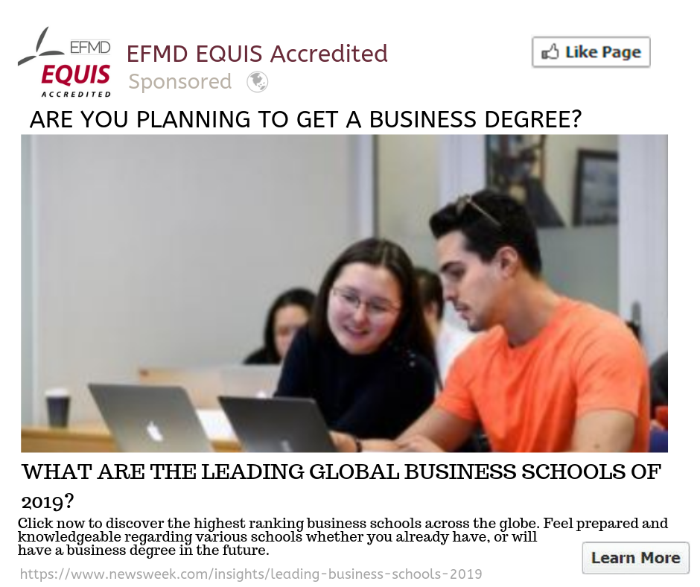
SPONSOR CONTENT DISTRIBUTION

Slide 23

Branded Content
  “How to help your students get more organized”
  “Track the status of your submittals in one easy-to-use dashboard”
  “Top 5 reasons to appoint a project manager for your RFPs”
Up to 400 words of written content
Tells and/or explains a single/idea/concept
Multi-purposed for anything desired
Lives on the client’s site, email blast, social platforms, etc.

Slide 24
Content in action
Lead generation
  Delivering carefully designed content
  that nurtures prospects through the
  buying cycle produces more qualified
  leads, maximizing utilization and
  bottom-line impact.
Brand building
  Drawing attention to unique qualities while helping to improve search rankings drives top-funnel traffic.
Retention & advocacy
  Build trust with useful and entertaining content throughout the customer relationship, helping cultivate repeat business.
Pipeline acceleration
  Accelerates purchase decisions by delivering the right content at the
  right time in the customer journey.

Slide 25
Millennials want e-books, whitepapers, blog posts, videos, and other how-to information… they are 2.5x more likely to be influenced by blogs or social networking sites.
Source: https://blog.hubspot.com/marketing/marketing-to-millennials

Slide 26
SEARCH MARKETING
Measurable KPI’s:
  Clicks to website
  Competitive impression share
  Conversions (calls, form completions, etc.)

Slide 27
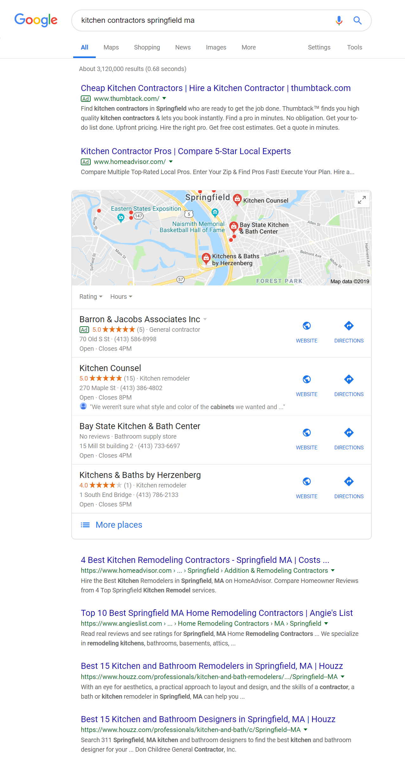
SEARCH MARKETING
Paid Search gets you here
When your business appears where customers are proactively searching for what you do, you can capture targeted audiences both browsing during pre-market research moments and in-market when ready to connect/hire/buy.
L
O
C
A
L
SEO gets you here

Slide 28
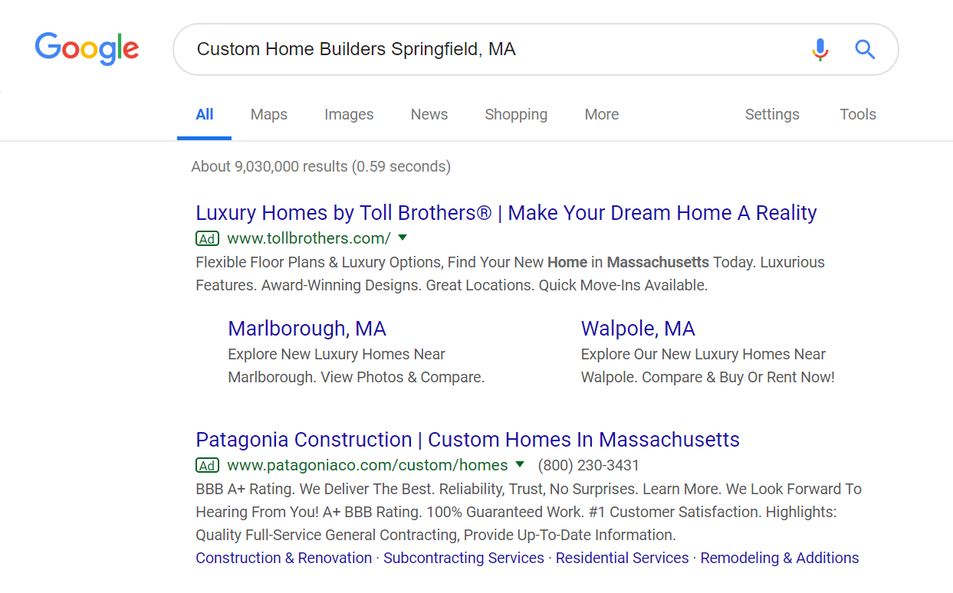
SEARCH ENGINE MARKETING
Keywords
3
Potential customer clicks on the ad and is taken to the most relevant page on your website
1
Potential customers type in targeted keywords into Search Engine
Ex. “Custom Home Builders Springfield, MA”
Paid Search
Results
Your ad shows up in results under Ads
2

Slide 29
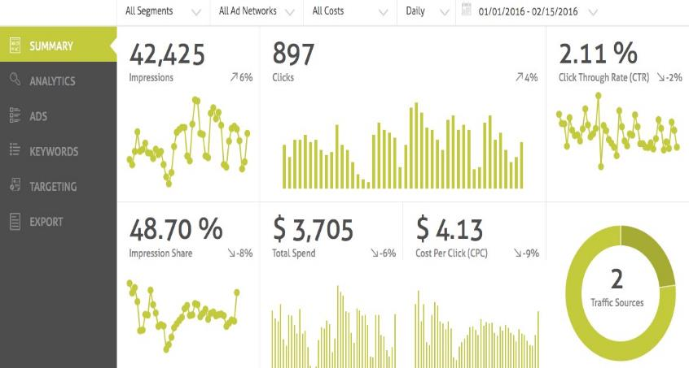
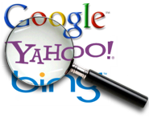
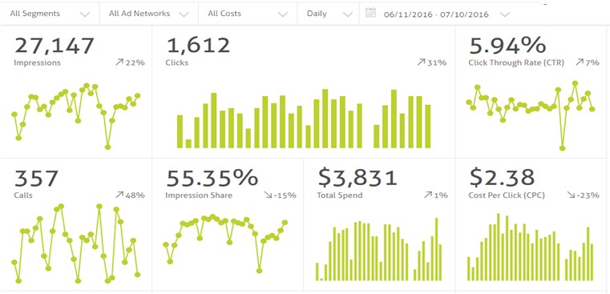
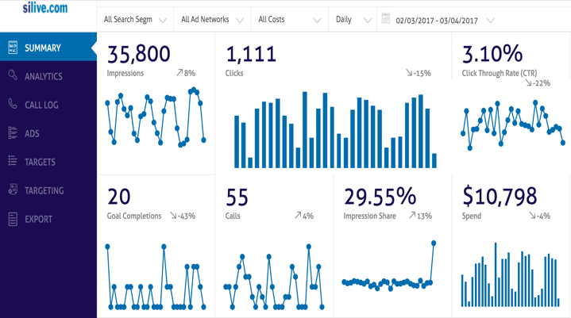
SEARCH ENGINE MARKETING
Campaign Set Up
Full Transparency Reporting
Ongoing Optimization

Slide 30
SEARCH ENGINE OPTIMIZATION
Measurable KPI’s:
  New users
  Traffic lift
  Content engagement
  Conversions (calls, form completions, chats, etc.)

Slide 31
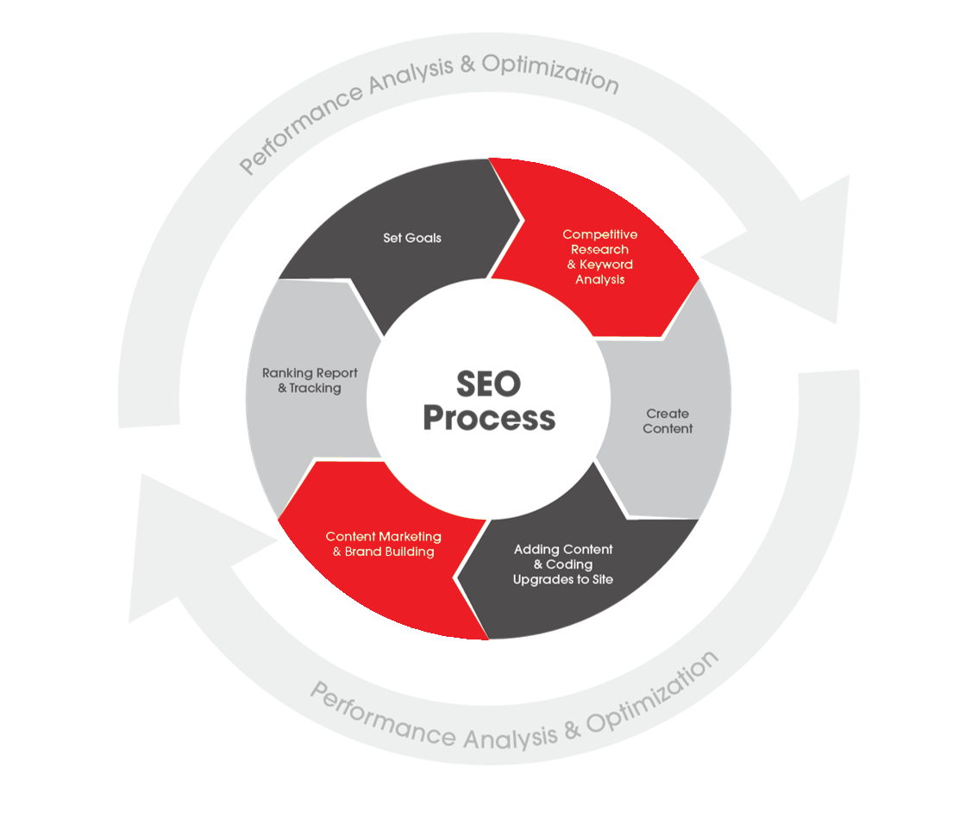
SEARCH ENGINE OPTIMIZATION
Receive heightened traffic from relevant sources (Google, Bing, etc.), longer audience engagement, measurable tracking data and increased organic rankings.
ORGANICALLY
FOUND
BE
Notes:
Your website is often your first opportunity to connect, engage and move customers into an actionable state.
Building equity in your owned, online property positively affects all marketing efforts that drive traffic to your site content.
On-page optimization is what a company’s website’s pages communicate to visitors
Off-page optimization is getting your brand connected across other authoritative websites
Together, over 200 different factors of On-page and Off-page elements make up organic rankings
Like a 401k, consistent input and patience are the best approach to maximizing SEO and on-site conversions
Effective SEO strategies aim to create a greater audience experience with your brand. Optimizing site content and building high-quality, authoritative links where the content can benefit from additional, relevant traffic are critical aspects to achieve this optimal experience.

Slide 32

Comprehensive Search
Engine Optimization
Highly customized premium service for businesses that need:
Increased relevant organic traffic nationally or regionally
To produce and execute a comprehensive strategy customized to their specific situation
To rank in highly competitive industry or have several brick and mortar locations.
Comprehensive site audit included.

Slide 33
SOCIAL MEDIA MARKETING
Measurable KPI’s:
Impressions to target audience
Clicks/leads
Engagement (likes, shares, retweets, follows, etc.)
Assisted conversions

Slide 34
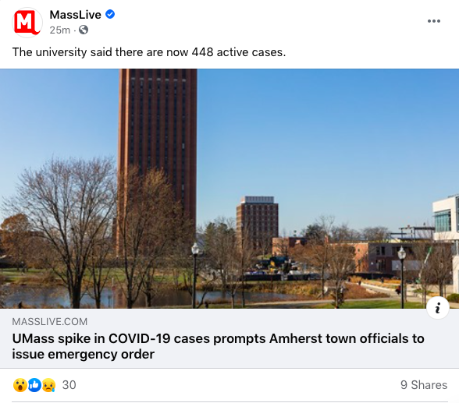
CO-BRANDED SOCIAL POSTS
Co-Branded posts run as paid partnerships on MassLive’s Facebook page. Strategically aligned with our trusted brand to enhance the client’s own brand recognition.
Benefit from the endorsement of a trusted provider of news and information in a highly engaged channel. ​
Promote events, contests, special offers and more. ​
Boosting each post allows us to reach MassLive’s more than 200K Facebook followers + find a new engaged audience.

Slide 35


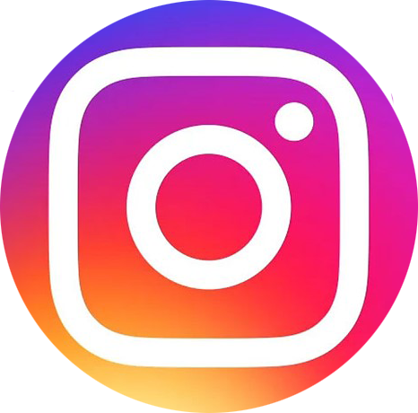


SOCIAL MEDIA MARKETING
Our social marketing programs provide
deep connections with consumers.
Our experts specialize in: social posts, social advertising, social lead generation and brand monitoring.
Leverage our first and third-party data to create customized audience segments for social campaign targeting, including geo-targeting.
Social adds impact when integrated into a comprehensive content marketing strategy.

Slide 36
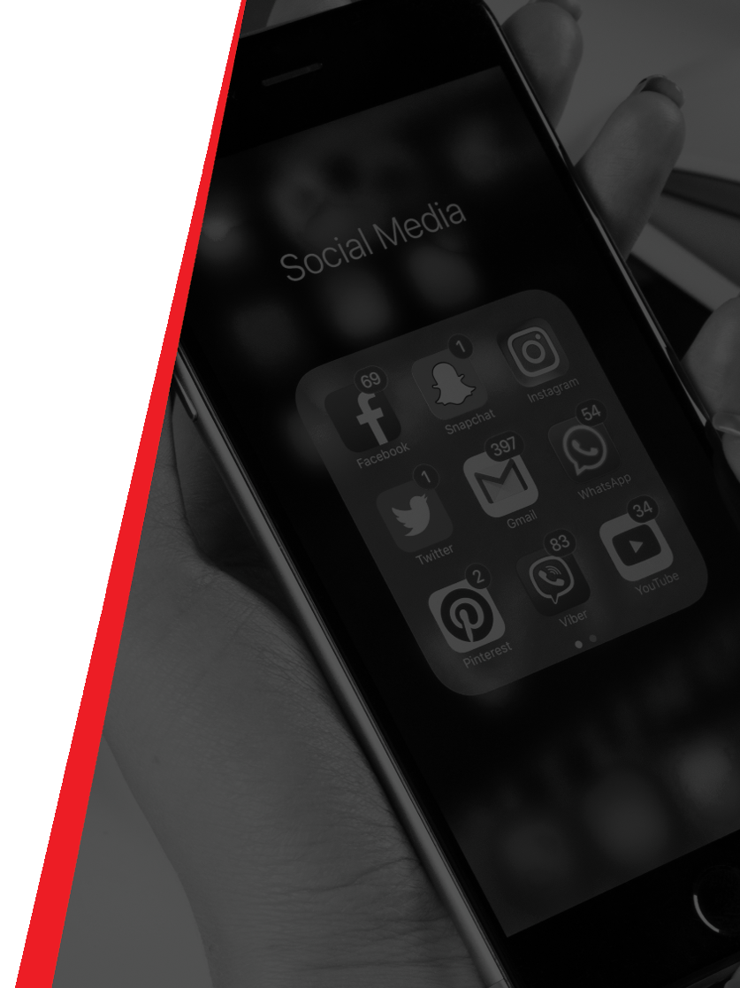

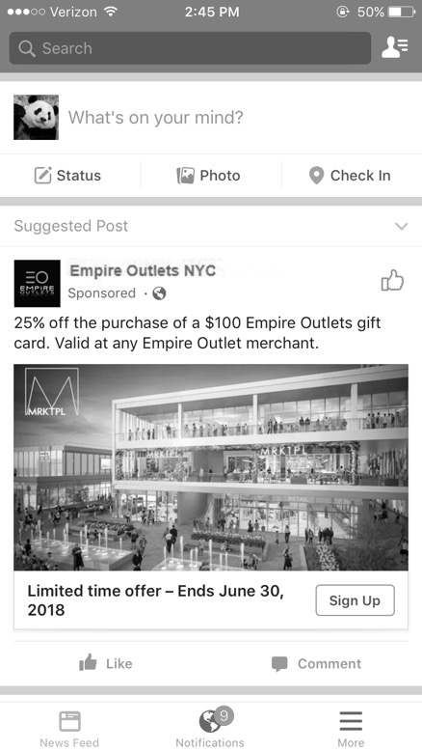


SOCIAL LEAD GENERATION
A unique and highly effective tactic to
gather consumer data while providing
value to the customer.
Possibilities include data collection in
exchange for special offers such as
coupons, discounts on gift cards etc.
The experience is seamless and remains
within the native Facebook environment.
Audience targeting takes advantage of
our first and third-party data and
geo-targeting capabilities.
1
2
3

Slide 37


FACEBOOK ADVERTISING
Facebook ads are targeted to users based on their location, demographic, and profile information.
There were 1.56 billion daily active Facebook users in March of 2019.
is the top platform for B2B and B2C businesses.
98% of B2C businesses
89% of B2B businesses
Sources: HootSuite “41 Facebook Stats That Matter to Marketers in 2019”. November 2018 Zephoria Digital Marketing “The Top 20 Valuable Facebook Statistics”. May 2019

Slide 38

PAID FACEBOOK ADVERTISING
In-Feed
Messenger
In-Stream (mid-roll)
Video
Lead Gen/Form Fill Ads
Event Promotion
Facebook Story Ads
Database Targeting
Look-alike Targeting
Re-messaging

Slide 39


INSTAGRAM ADVERTISING
Instagram advertising is method of paying to post sponsored content on the platform to reach a larger and more targeted audience.
There Are 500 Million+ Instagram Accounts Active Every Day
Ad Recall is 2.8x Higher on Instagram than other industry norms
Source: Jumper Media “33 Jaw-Dropping Instagram Statistics for 2019”. January 2019

Slide 40





INSTAGRAM ADVERTISING
vineyardvines
In-Feed Static Image Ads
In-Feed Video Ads
Instagram Stories
Audience Targeting
Database Targeting
Look-alike Targeting
vineyardvines shop our Shark Week Collection! Be prepared!

Slide 41

SOCIAL DISPLAY (MOBILE ONLY)
Bring an organic Facebook post into a unique advertising format on MassLive.com
Targetable to behaviors, geographies, and demographics using proprietary 1st party data
This ad unit serves on mobile devices within article pages.
Complete with social interaction buttons (reactions, shares).
Adds a call to action with a click through of your choice

Slide 42

LINKEDIN ADVERTISING
Advertising on LinkedIn helps businesses of any size achieve their goals.
2 million posts are published per day on LinkedIn.
There are over 610 million active professionals on LinkedIn. You can target them by job title, function, industry, and more.
Source: HootSuite ”16 LinkedIn Statistics That Matter to Marketers in 2019”. February 2019 LinkedIn “Advertise on LinkedIn” 2019

Slide 43



LINKEDIN ADVERTISING
Sponsored Posts
  Static Image & Video
Side Rail Ads
Target People Based On
Education
  Job titles & types
  Employers
  Industries
  And More

Slide 44
SOCIAL AUDIENCES
PLEASE INSERT AUDIENCE RESEARCH HERE

Slide 45
WEBSITE DEVELOPMENT
Benefits:
Mobile friendly
UX tested
Foundational SEO
Client owns content forever

Slide 46


BUILDING & OPTIMIZING WEBSITES
We build websites.
It’s what we do.
Advance maintains the #1 news and info websites in eleven different sites around the country
Everyday our professionals attract traffic to our websites looking for relevant and timely content. We can do the same for you.
We put this experience toward development of custom websites, optimized across devices and designed for conversion for our clients.
See our work here.

Slide 47
75% of buyers admit to making judgements on a company’s credibility based on the company’s website design.
Source: SWEOR “27 Eye-Opening Website Statistics: Is Your Website Costing You Clients?”. April, 2019 themes.responsively.com

Slide 48






LANDING PAGES Built for Conversion
  SEO friendly content
  Custom, mobile-friendly site
  Unlimited content
  Real-time analytic reporting
  Google Maps Integration
  Email account setup
  Customer and SEO friendly page speed
  Form fills & Click to Call

Slide 49
A platform that maximizes web conversions.
Leveraging human augmented artificial intelligence.
1. Rapidly increase conversion – for landing pages, websites or campaigns, new offerings or new target segments
2. Improve understanding of prospective clients and their needs
3. Optimize value proposition, messaging, and imagery per audience
4. Benchmark to partner sites – and learn from the better ones

Slide 50
How Can WEVO Help Increase Customer Acquisition
1. Rapidly increase conversion – for landing pages, websites or campaigns, new offerings or new target segments
2. Improve understanding of prospective clients and their needs
3. Optimize value proposition, messaging, and imagery per audience
4. Benchmark to partner sites – and learn from the better ones

Slide 51

How Do You Use WEVO?

Slide 52
DATA INSIGHTS
Benefits:
Data-based answers to the questions you have
Insights and actionable information about your audience

Slide 53


DATABASE PROFILE REPORT
Providing Insights for Smarter Business and Marketing Decisions
Expert-level picture and analysis of your customer/prospect base to help identify and highlight opportunities.
Learn how to reach and engage current customer base more efficiently and effectively.

Slide 54
DATABASE PROFILE REPORT- THE BEST CUSTOMER
Perception vs. Reality
Your business' perception of the target audience:
Parents
Children 2-16
Active Lifestyle
Parents (41%)
Age 30-55
Children 2-16
Active Lifestyle
Own a Home
Suburban
Single Moms (59%)
Age 25-45
Children 2-16
Active Lifestyle
Renter
Urban
CRM analysis shows two distinct audiences:

Slide 55

CONSUMER SURVEYS
Understanding Consumer Opinion, Satisfaction and Expectations
Ask questions about areas/topics your business wants to gain consumer feedback in.
Provide data that will be analyzed to deliver insights to improve marketing messages, business decisions, positioning, and product offerings.

Slide 56

DIGITAL CONVERSATION ANALYSIS
Statistical Evaluation of Digital Conversations and Their True Underlying Meanings
Research and collect conversations across the digital landscape.
Identify evolving trends, gaps, and opportunities to improve perception, positioning against competitors, guide business strategy, and evaluate marketing messages.

Slide 57

QUALITATIVE RESEARCH
How your business will benefit:
Receive direct consumer feedback and answers to questions important to your business:
  Why do you shop at store X vs. store Y?
  How do you use product X?
  How do you feel about candidate B?
Test ideas, new concepts, products, re-branding and more before launching or uncover new opportunities, niche markets.

Slide 58

FULL MARKETING STRATEGY BASED ON CONSUMER INSIGHTS
We offer enhanced database profiling and segmentation through CRM behavioral analysis combined with an overlay of demographic and psychographic data, 200 available demographics parameters, to building audience persona(s)
Audience Engagement (alumni)
Purchase/Shopping Cart Analysis
Revenue and Profitability Drivers
Market Trends, Sizing and Share​
Lookalike Acquisition Modeling​
Upsell/cross-sell ​
Pricing optimization​
And more...

Slide 59
TARGETED EMAIL MARKETING
Measurable KPI’s:
Delivery rate to target audience
Unique & total open rates
CTR
Customer match backs

Slide 60

EMAIL MARKETING
Our multi-channel email platform reaches and influences consumers directly by combining your exclusive message with highly targeted follow-up display ads, producing significant campaign response lift.

Slide 61

DIRECTLY REACH CUSTOMERS
E-mail Blasts from your business highlighting your promotions, deals, events or overall brand.
Sent to targetable audience segments in your markets
We partner with a leading email acquisition company that uses verified data to reach targetable audiences

Slide 62

RE-TARGETED EMAIL
Re-target users who receive, open or click the email with a display ad on whatever device they’re using
Talk to the same individuals across email, display, mobile and Facebook – a true
multi-channel / program experience
On average, email campaigns see a 30% lift in engagement when multi-channel tactics are added

Slide 63








EMAIL WITH MULTI-CHANNEL DISPLAY
Reach your audience with highly targeted, cost-effective email campaigns that deliver results!
Email marketing measurement:
  Delivery Rate of concentrated frequency to your targeted audience across multiple channels
  Unique & Total Audience Open Rates measured against similar marketing tactics
Additional Reporting opportunities available to identify those exact users who engaged with the campaign & match back to purchase data
  *Targeted Email Marketing for New Customers is not the same as measuring existing customer delivery industry metrics
48
Notes:
SAY ALOUD
Delivers your message via email, then targets the same individual via display advertising
Display served where media is consumed – including desktop, tablet, in-app mobile and social (Facebook and Instagram), – whether they engage with the email or not
Ability to target any geography, behavior and/or demographic*
Rigorous list data-hygiene and email verification every 30 days and again prior to each deployment for more effective delivery
Initial 2-day then final 7-day reports are provided for each email deployment
CTR and unsubscribe rates
Link click engagement

Slide 64


MASSLIVE REAL DEALS EMAIL
Engage with MassLive’s email database of subscribers that opt-in to receive deals on products, services, events, and more.
Over 95,000 subscribers
99.7% average delivery rate
Share special deals or promote contests
Deliver your brand message through a trusted source
100% share of voice

Slide 65
CREATIVE SERVICES
Benefits:
Multi-platform, digital forward designers
Branding; positioning
Compelling visuals

Slide 66
CAPABILITIES
Videography &
Photography
Video editing
Landing page creation
Graphic design for all digital and social platforms
If you’re going to hire a team to assist you with marketing, don’t skimp on the creative

Slide 67


VIDEO CREATION
Notes:
Is this meant to be a placeholder for video exmaples?

Slide 68
LANDING PAGES
Landing pages increase conversions. They provide a simple, frictionless experience for potential customers and an environment where you can focus your visitor’s attention exclusively on the action you want them to take.
Why are they effective?
Match marketing messages
Generate leads
Eliminate distractions
Notes:
SELLER TAKE NOTE THIS COULD BE HERE OR AS PART OF WEB DEV SOLUTION – NOT BOTH

Slide 69






CREATIVE CONCEPT & DESIGN

Slide 70
CASE STUDIES

Slide 71


CLIENT RESULTS
MOTORSPORTS COMPANY INCREASES KEY PRODUCT SALES BY 50% WITH STRATEGIC SEM PLAN
CHALLENGE: Lack of a high search ranking, lost amongst their competitors
SOLUTION: Crafted an SEM plan focusing on key products for new client acquisition
RESULTS: 58% year over year increase in website traffic
30% of their website traffic attributed to paid search
50% increase in sales for key products.
150% increase in sales of leading brand’s product line
Overall quality lead activity has increased by 25%
Notes:
CHALLENGE
A Western Mass Motorsports company was having challenges with brand awareness and poor online presence. The business was lacking a high search ranking and was being lost among their competitors.
KPI
Increase website traffic
Track and increase phone leads
STRATEGIES
MassLive Media evaluated their search engine marketing and created a custom plan focusing on key products for new client acquisition. The strategy included a re-marketing component serving general brand messaging to consumers who engaged with their website. A con-questing plan was also launched to bid on competitors within Google. Call tracking was implemented to monitor and record phone leads.
RESULTS
58% year over year increase in website traffic
30% of their website traffic attributed to paid search
50% increase in sales for key products.
150% increase in sales of leading brand’s product line
Overall quality lead activity has increased by 25%
Con-questing click through rate of 4.21%
Over 300 calls in 6 months
As a result of their sales growth, the business competed with over 30 businesses in the region to receive a top brand’s Dealer of the Year Award
KEY CLIENT FINDINGS
Their previous SEM plan managed by another vendor wasn’t being optimized for their business
Keyword research fueled the strategy to focus on specific products and target lower funnel sales opportunities
Call tracking allowed management to monitor their customer service and identify leads in need of follow up

Slide 72

CLIENT RESULTS
INDUSTRIAL AND COMMERCIAL MFTR INCREASES SITE TRAFFIC 48% DUE TO OPTIMIZED SEM CAMPAIGN
CHALLENGE: Capitalize on full potential of the search market for their industry
SOLUTION: Launched an SEM plan to drive site traffic to 4 key site sections to increase consumer engagement and education of products
RESULTS: Over 43% search impression share of targeted keywords
Notable increase in click-throughs
48% increase in overall site traffic with substantial improvements to key sections
Overall quality lead activity increased by 25%
Maintained low bounce rate of 52%
Notes:
CHALLENGE
A leading industrial and commercial manufacturer located in Western MA was looking to optimize their search strategy. Their goal was to capitalize on their full potential of the search market for their industry.
KPI
Gain visibility in search by ranking on first page of Google search results
Increase in overall site traffic; drive traffic to 4 key site sections to increase consumer engagement
STRATEGIES
MassLive Media launched a customized SEM campaign optimized for the client’s specific products and services. An emphasis was placed on driving traffic to 4 key site sections to increase consumer engagement and education of products.
RESULTS
Over 43% search impression share of targeted keywords
Notable increase in click-throughs: 16,016 clicks during the campaign; 3.7% click-through rate
48% increase in overall site traffic with substantial improvements to key sections
Maintained low bounce rate of 52%
Overall quality lead activity has increased by 25%
KEY CLIENT FINDINGS
Organic search is not enough to support sufficient levels of web traffic
A search engine marketing plan catered to your target consumer supports online visibility and increased conversion of quality leads.
The ad campaigns reached the right targeted audience as indicated by preserving their already low bounce rate
Partnering with experts in the digital marketing field was of great benefit to the business. Due to resource constraints it was challenging to manage the daily search activities internally, while MassLive Media proved to be an asset by ultimately acting as an extension of the marketing team.

Slide 73
CLIENT FEEDBACK
“MassLive Media is a true partner. I am very impressed with the ongoing support and attention given to our account. I am so pleased with the overall experience even recommended their service to a customer for their SEM needs.”
-Marketing Director, Industrial and Commercial Manufacturer
…
“MassLive Media’s experience and knowledge has been imperative to growing our website traffic and driving our sales goals. We recommend MassLive Media to any business looking for a robust digital marketing plan that is customized for your needs and comes with the personal support of local professionals.”
-General Manager, Outdoor Recreation Retailer
…
“MassLive Media was an ideal partner for us as we dipped our toes into the waters of digital display and optimization. They recommended fitting solutions for our specific needs and budget and provided us with an ongoing education as we progressed through our 2016 campaign.”
-Chief Branding and Communications Officer
…

